Slide 1
RooFit
Introduction
Basic functionality
Addition and convolution
Building multidimensional models
Managing data, discrete variables
and simultaneous fits
More on likelihood calculation and minimization
Validation studies
Wouter Verkerke, NIKHEF

Slide 2
1
Introduction
& Overview
Introduction
Some basics statistics
RooFit design philosophy
Wouter Verkerke, NIKHEF

Slide 3
Introduction – Purpose
→
Model the distribution of observables x in terms of
  Physical parameters of interest p
  Other parameters q to describe detector effects
  (resolution,efficiency,…)
→
→
RooFit
→
→
→
Probability density function F(x;p,q)
  normalized over allowed range of the observables x
  w.r.t the parameters p and q
Wouter Verkerke, NIKHEF

Slide 4
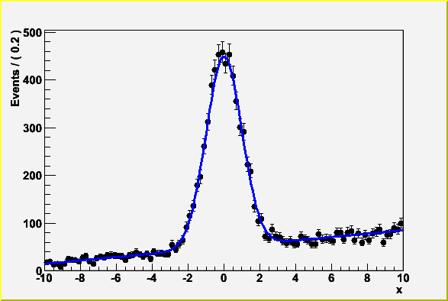
Introduction -- Focus: coding a probability density function
Focus on one practical aspect of many data analysis in HEP: How do you formulate your p.d.f. in ROOT
  For ‘simple’ problems (gauss, polynomial), ROOT built-in models well sufficient
  But if you want to do unbinned ML fits, use non-trivial functions, or work with multidimensional functions you are quickly running into trouble
Wouter Verkerke, NIKHEF

Slide 5
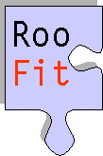

Introduction – Relation to ROOT
Extension to ROOT – (Almost) no overlap with existing functionality
Data Modeling
ToyMC data
Generation
Model
Visualization
Data/Model
Fitting
C++ command line
interface & macros
MINUIT
Data management &
histogramming
I/O support
Graphics interface
Wouter Verkerke, NIKHEF

Slide 6
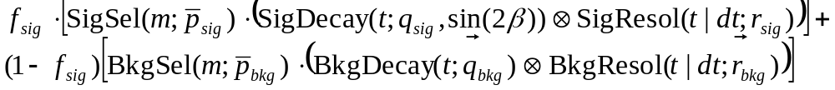
Introduction – Why RooFit was developed
BaBar experiment at SLAC: Extract sin(2β) from time dependent CP violation of B decay: e⁺e⁻ → Y(4s) → BB
  Reconstruct both Bs, measure decay time difference
  Physics of interest is in decay time dependent oscillation
Many issues arise
  Standard ROOT function framework clearly insufficient to handle such complicated functions → must develop new framework
  Normalization of p.d.f. not always trivial to calculate → may need numeric integration techniques
  Unbinned fit, >2 dimensions, many events → computation performance important → must try optimize code for acceptable performance
  Simultaneous fit to control samples to account for detector performance
Wouter Verkerke, NIKHEF

Slide 7
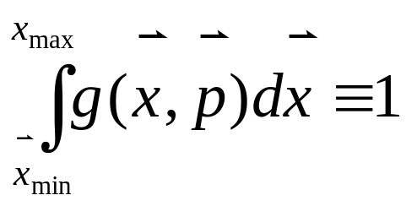
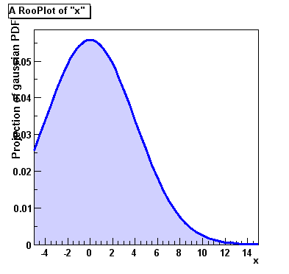
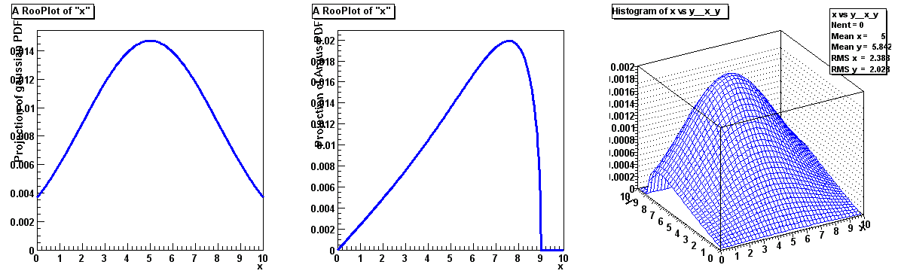


Mathematic – Probability density functions
Probability Density Functions describe probabilities, thus
  All values most be >0
  The total probability must be 1 for each p, i.e.
  Can have any number of dimensions
Note distinction in role between parameters (p) and observables (x)
  Observables are measured quantities
  Parameters are degrees of freedom in your model
Wouter Verkerke, NIKHEF

Slide 8
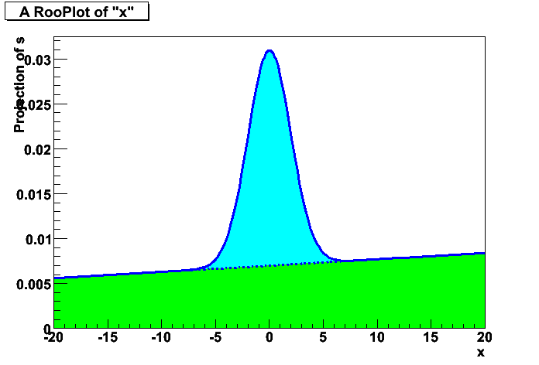
Math – Functions vs probability density functions
Why use probability density functions rather than ‘plain’ functions to describe your data?
  Easier to interpret your models.
  If Blue and Green pdf are each
  guaranteed to be normalized to 1,
  then fractions of Blue,Green can
  be cleanly interpreted as #events
  Many statistical techniques only
  function properly with PDFs
  (e.g maximum likelihood)
  Can sample ‘toy Monte Carlo’ events
  from p.d.f because value is always
  guaranteed to be >=0
So why is not everybody always using them
  The normalization can be hard to calculate
  (e.g. it can be different for each set of parameter values p)
  In >1 dimension (numeric) integration can be particularly hard
  RooFit aims to simplify these tasks
Wouter Verkerke, NIKHEF

Slide 9
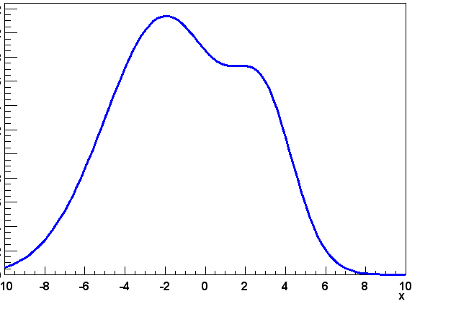
Math – Event generation
For every p.d.f, can generate ‘toy’ event sample as follows
  Determine maximum PDF value by repeated random sample
  Throw a uniform random value (x) for the observable to be generated
  Throw another uniform random number between 0 and fmax
  If ran*f_{max} < f(x) accept x as generated event
  More efficient techniques exist (discussed later)
f_{max}
f(x)
x
Wouter Verkerke, NIKHEF

Slide 10
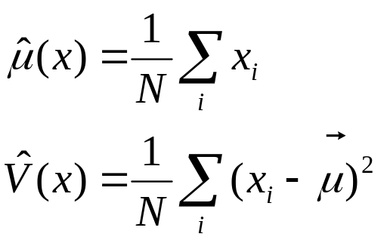

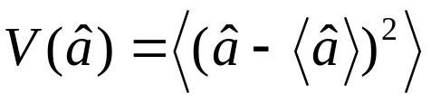
Math – What is an estimator?
An estimator is a procedure giving a value for a parameter or a property of a distribution as a function of the actual data values, i.e.
A perfect estimator is
  Consistent:
  Unbiased – With finite statistics you get the right answer on average
  Efficient
  There are no perfect estimators for real-life problems
← Estimator of the mean
← Estimator of the variance
This is called the
Minimum Variance Bound
Wouter Verkerke, NIKHEF

Slide 11

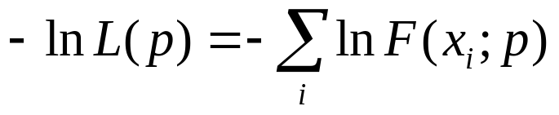
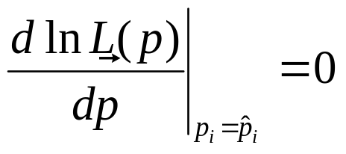
Math – The Likelihood estimator
Definition of Likelihood
  given D(x) and F(x;p)
  For convenience the negative log of the Likelihood is often used
Parameters are estimated by maximizing the Likelihood, or equivalently minimizing –log(L)
Functions used in likelihoods must
be Probability Density Functions:
Wouter Verkerke, NIKHEF

Slide 12
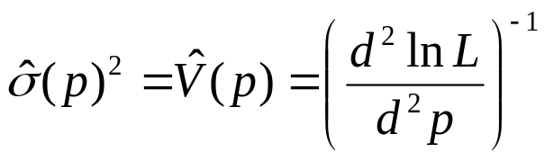
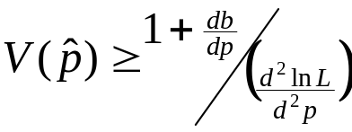
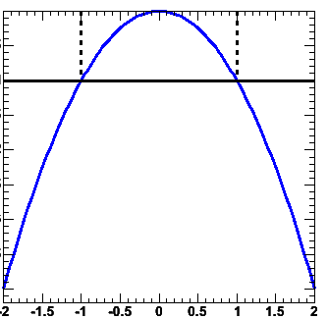
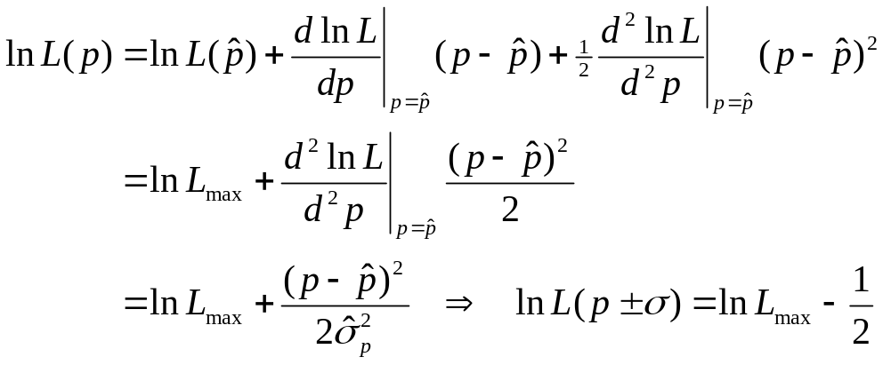

Math – Variance on ML parameter estimates
Estimator for the parameter variance is
  I.e. variance is estimated from
  2nd derivative of –log(L) at minimum
  Valid if estimator is
  efficient and unbiased!
Visual interpretation of variance estimate
  Taylor expand –log(L) around minimum
From Rao-Cramer-Frechet
inequality
b = bias as function of p,
inequality becomes equality
in limit of efficient estimator
0.5
-log(L)
p
Wouter Verkerke, NIKHEF

Slide 13

Math – Properties of Maximum Likelihood estimators
In general, Maximum Likelihood estimators are
  Consistent (gives right answer for N→∞)
  Mostly unbiased (bias ∝1/N, may need to worry at small N)
  Efficient for large N (you get the smallest possible error)
  Invariant: (a transformation of parameters
  will Not change your answer, e.g
MLE efficiency theorem: the MLE will be unbiased and efficient if an unbiased efficient estimator exists
Use of 2nd derivative of –log(L)
for variance estimate is usually OK
Wouter Verkerke, NIKHEF

Slide 14
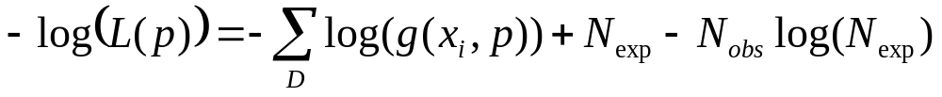
Math – Extended Maximum Likelihood
Maximum likelihood information only parameterizes shape of distribution
  I.e. one can determine fraction of signal events from ML fit, but not number of signal events
Extended Maximum likelihood add extra term
  Clever choice of parameters will allows us to extract N_{sig} and N_{bkg} in one pass ( N_{exp}=N_{sig}+N_{bkg}, f_{sig}=N_{sig}/(N_{sig}+N_{bkg}) )
Log of Poisson(Nexp,Nobs)
(modulo a constant)
Wouter Verkerke, NIKHEF

Slide 15



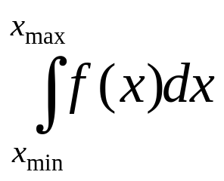
RooFit core design philosophy
Mathematical objects are represented as C++ objects
Mathematical concept
RooFit class
variable
RooRealVar
function
RooAbsReal
PDF
RooAbsPdf
space point
RooArgSet
integral
RooRealIntegral
list of space points
RooAbsData
Wouter Verkerke, NIKHEF

Slide 16
RooFit core design philosophy
Represent relations between variables and functions
as client/server links between objects
f(x,y,z)
Math
RooAbsReal f
RooFit
diagram
RooRealVar x
RooRealVar y
RooRealVar z
RooFit
code
RooRealVar x(“x”,”x”,5) ;
RooRealVar y(“y”,”y”,5) ;
RooRealVar z(“z”,”z”,5) ;
RooBogusFunction f(“f”,”f”,x,y,z) ;
Wouter Verkerke, NIKHEF

Slide 17
RooFit core design philosophy
Composite functions → Composite objects
f(w,z)
g(x,y)
f(g(x,y),z) = f(x,y,z)
Math
RooAbsReal f
RooAbsReal f
RooFit
diagram
RooRealVar w
RooRealVar z
RooAbsReal g
RooRealVar z
RooAbsReal g
RooRealVar x
RooRealVar y
RooRealVar x
RooRealVar y
RooFit
code
RooRealVar x(“x”,”x”,2) ;
RooRealVar y(“y”,”y”,3) ;
RooGooFunc g(“g”,”g”,x,y) ;
RooRealVar w(“w”,”w”,0) ;
RooRealVar z(“z”,”z”,5) ;
RooFooFunc f(“f”,”f”,w,z) ;
RooRealVar x(“x”,”x”,2) ;
RooRealVar y(“y”,”y”,3) ;
RooGooFunc g(“g”,”g”,x,y) ;
RooRealVar z(“z”,”z”,5) ;
RooFooFunc f(“f”,”f”,g,z) ;
Wouter Verkerke, NIKHEF

Slide 18
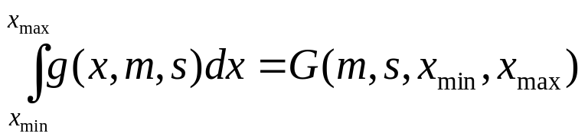
RooFit core design philosophy
Represent integral as an object,
instead of representing integration as an action
Math
g(x,m,s)
RooFit
diagram
RooRealIntegral G
RooGaussian g
RooRealVar x
RooRealVar s
RooGaussian g
RooRealVar m
RooRealVar x
RooRealVar s
RooRealVar m
RooFit
code
RooRealVar x(“x”,”x”,2,-10,10)
RooRealVar s(“s”,”s”,3) ;
RooRealVar m(“m”,”m”,0) ;
RooGaussian g(“g”,”g”,x,m,s)
RooAbsReal *G =
g.createIntegral(x) ;
Wouter Verkerke, NIKHEF

Slide 19
Object-oriented data modeling
In RooFit every variable, data point, function, PDF represented in a C++ object
  Objects classified by data/function type they represent,
  not by their role in a particular setup
  All objects are self documenting
    Name - Unique identifier of object
    Title – More elaborate description of object
Initial range
RooRealVar mass(“mass”,”Invariant mass”,5.20,5.30) ;
RooRealVar width(“width”,”B0 mass width”,0.00027,”GeV”);
RooRealVar mb0(“mb0”,”B0 mass”,5.2794,”GeV”) ;
RooGaussian b0sig(“b0sig”,”B0 sig PDF”,mass,mb0,width);
Objects
representing
a ‘real’ value.
Initial value
Optional unit
PDF object
References to variables
Wouter Verkerke, NIKHEF

Slide 20
RooFit designed goals for easy-of-use in macros
Mathematical concepts mimicked as much as possible in class design
  Intuitive to use
Every object that can be constructed through composition should be fully functional
  No implementation level restrictions
  No zombie objects
All methods must work on all objects
  Integration, toyMC generation, etc
  No half-working classes
Wouter Verkerke, NIKHEF

Slide 21
2
Basic
Functionality
Creating a p.d.f
Basic fitting, plotting, event generation
Some details on normalization, event generation
Library of basic shapes (including non-parametric shapes)
Wouter Verkerke, NIKHEF

Slide 22
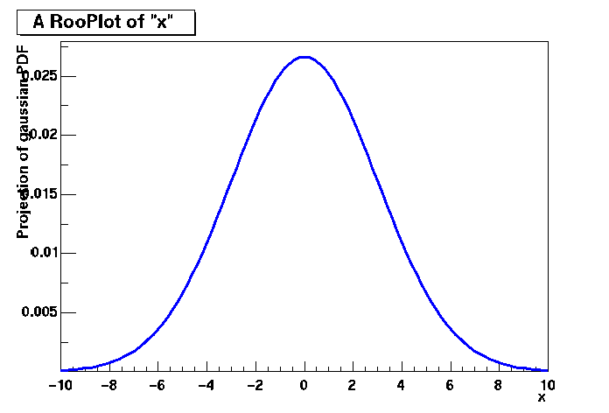
Basics – Creating and plotting a Gaussian p.d.f
Setup gaussian PDF and plot
// Build Gaussian PDF
RooRealVar x("x","x",-10,10) ;
RooRealVar mean("mean","mean of gaussian",0,-10,10) ;
RooRealVar sigma("sigma","width of gaussian",3) ;
RooGaussian gauss("gauss","gaussian PDF",x,mean,sigma) ;
// Plot PDF
RooPlot* xframe = x.frame() ;
gauss.plotOn(xframe) ;
xframe->Draw() ;
Axis label from gauss title
Unit
normalization
A RooPlot is an empty frame
capable of holding anything
plotted versus it variable
Plot range taken from limits of x
Wouter Verkerke, NIKHEF

Slide 23
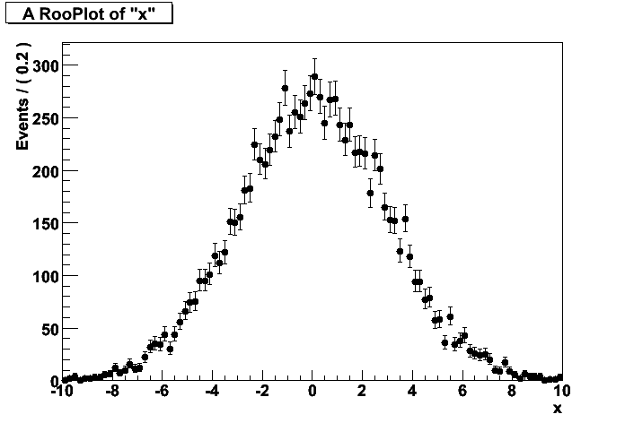
Basics – Generating toy MC events
demo1.cc
Generate 10000 events from Gaussian p.d.f and show distribution
// Generate a toy MC set
RooDataSet* data = gauss.generate(x,10000) ;
// Plot PDF
RooPlot* xframe = x.frame() ;
data->plotOn(xframe) ;
xframe->Draw() ;
Returned dataset is unbinned
dataset (like a ROOT TTree with
a RooRealVar as branch buffer)
Binning into histogram is performed
in data->plotOn() call
Wouter Verkerke, NIKHEF

Slide 24
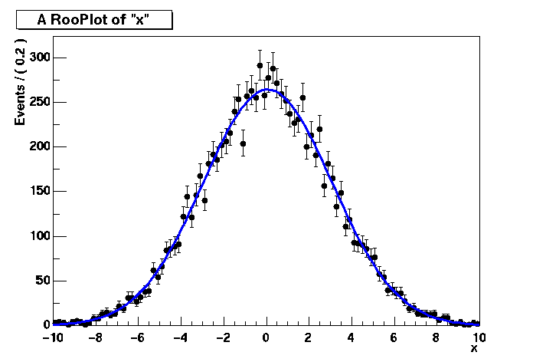
Basics – ML fit of p.d.f to unbinned data
demo1.cc
// ML fit of gauss to data
gauss.fitTo(*data) ;
(MINUIT printout omitted)
// Parameters if gauss now
// reflect fitted values
mean.Print()
RooRealVar::mean = 0.0172335 +/- 0.0299542
sigma.Print()
RooRealVar::sigma = 2.98094 +/- 0.0217306
// Plot fitted PDF and toy data overlaid
RooPlot* xframe2 = x.frame() ;
data->plotOn(xframe2) ;
gauss.plotOn(xframe2) ;
xframe2->Draw() ;
PDF
automatically
normalized
to dataset
Wouter Verkerke, NIKHEF

Slide 25
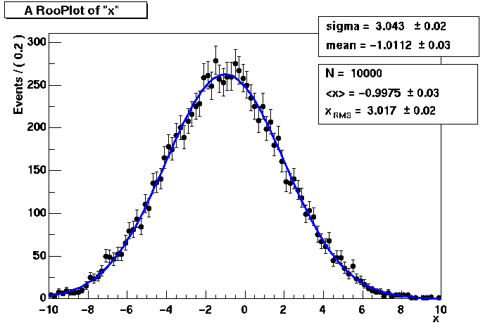
Basics – RooPlot Decoration
A RooPlot is an empty frame that can contain
  RooDataSet projections
  PDF and generic real-valued function projections
  Any ROOT drawable object (arrows, text boxes etc)
Adding a dataset statistics box / PDF parameter box
RooPlot* frame = x.frame() ;
data.plotOn(xframe) ;
pdf.plotOn(xframe) ;
pdf.paramOn(xframe,data) ;
data.statOn(xframe) ;
xframe->Draw() ;
Wouter Verkerke, NIKHEF

Slide 26
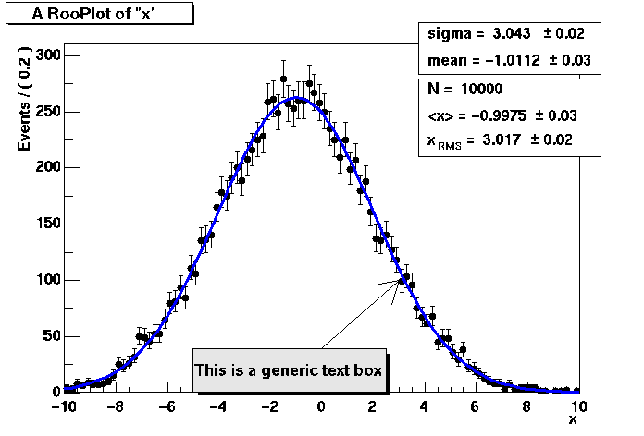
Basics – RooPlot decoration
Adding generic ROOT text boxes, arrows etc.
TPaveText* tbox = new TPaveText(0.3,0.1,0.6,0.2,"BRNDC");
tbox->AddText("This is a generic text box") ;
TArrow* arr = new TArrow(0,40,3,100) ;
xframe2->addObject(arr) ;
xframe2->addObject(tbox) ;
You can save a RooPlot
with all its decorations
in a ROOT file
Wouter Verkerke, NIKHEF

Slide 27
Basics – Observables and parameters of Gauss
Class RooGaussian has no intrinsic notion of distinction between observables and parameters
Distinction always implicit in use context with dataset
  x = observable (as it is a variable in the dataset)
  mean,sigma = parameters
Choice of observables (for unit normalization) always passed to gauss.getVal()
gauss.getVal() ; // Not normalized (i.e. this is _not_ a pdf)
gauss.getVal(x) ; // Guarantees Int[xmin,xmax] Gauss(x,m,s)dx==1
gauss.getVal(s) ; // Guarantees Int[smin,smax] Gauss(x,m,s)ds==1
Wouter Verkerke, NIKHEF

Slide 28
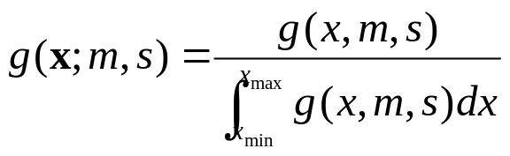
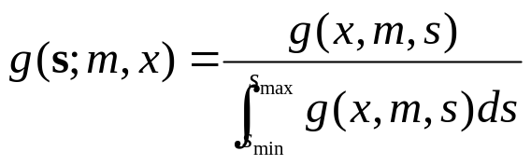
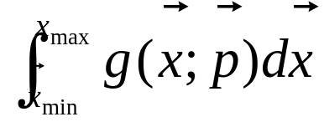
How does it work – Normalization
Flexible choice of normalization facilitated by explicit normalization step in RooFit p.d.f.s
Supporting class RooRealIntegral responsible for calculation of any
  Negotiation with p.d.f on which (partial) integrals it can internally perform analytically
  Missing parted are supplemented with numerical integration
  Class RooRealIntegral can in principle integrate everything.
gauss.getVal(x)
gauss.getVal(s)
Wouter Verkerke, NIKHEF

Slide 29
How does it work – Normalization
A peak in the code of class RooGaussian
// Raw (unnormalized value) of Gaussian
Double_t RooGaussian::evaluate() const {
Double_t arg= x - mean;
return exp(-0.5*arg*arg/(sigma*sigma)) ;
}
// Advertise that x can be integrated internally
Int_t RooGaussian::getAnalyticalIntegral(RooArgSet& allVars,
RooArgSet& analVars, const char* /*rangeName*/) const {
if (matchArgs(allVars,analVars,x)) return 1 ;
return 0 ;
}
// Implementation of analytical integral over x
Double_t RooGaussian::analyticalIntegral(Int_t code,
const char* rname) const {
static const Double_t root2 = sqrt(2.) ;
static const Double_t rootPiBy2 = sqrt(atan2(0.0,-1.0)/2.0);
Double_t xscale = root2*sigma;
return rootPiBy2*sigma*(RooMath::erf((x.max(rname)-mean)/xscale)
-RooMath::erf((x.min(rname)-mean)/xscale));
}
Wouter Verkerke, NIKHEF

Slide 30
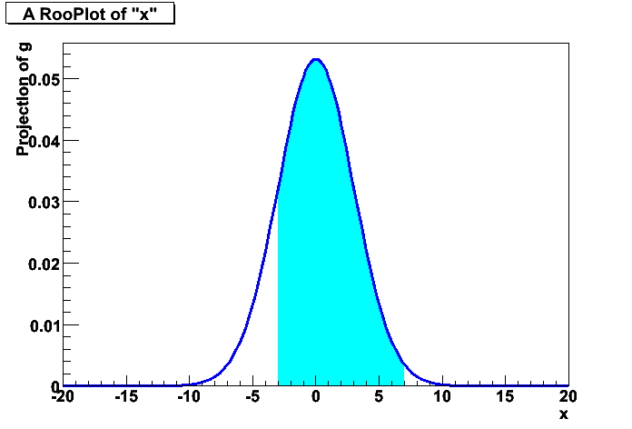
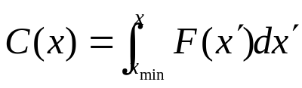
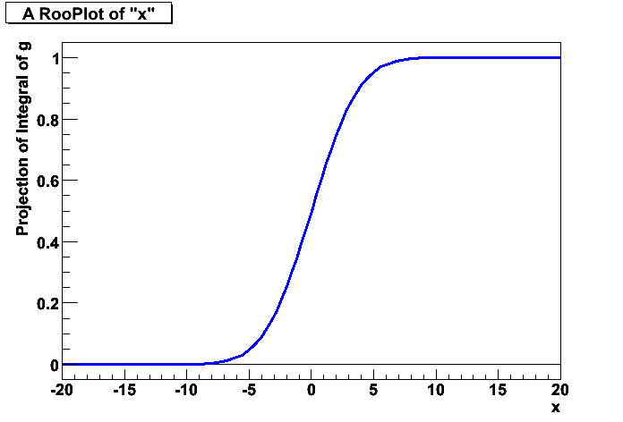
Basics – Integrals over p.d.f.s
It is easy to create an object representing integral over a normalized p.d.f in a sub-range
Similarly, one can also request
the cumulative distribution function
x.setRange(“sig”,-3,7) ;
RooAbsReal* ig = g.createIntegral(x,NormSet(x),Range(“sig”)) ;
cout << ig.getVal() ;
0.832519
mean=-1
cout << ig.getVal() ;
0.743677
RooAbsReal* cdf = gauss.createCdf(x) ;
RooPlot* frame = x.frame() ;
cdf->plotOn(frame)->Draw() ;
Wouter Verkerke, NIKHEF

Slide 31
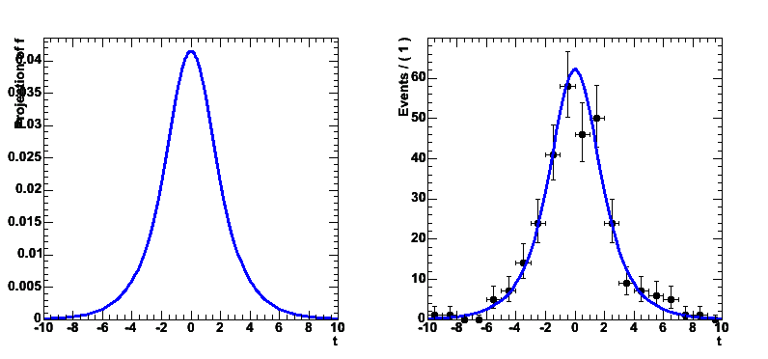
How does it work – toy event generation
By default RooFit implements an accept/reject sampling technique to generate toy events from a p.d.f.
  Determine maximum of function f_{max}
  Throw random number x
  Throw another random number y
  If y<f(x)/f_{max} keep x,
  otherwise return to step 2)
f_{max}
y
x
Wouter Verkerke, NIKHEF

Slide 32
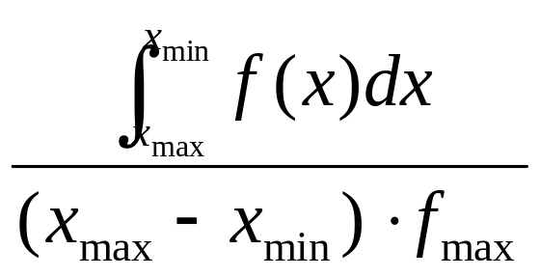
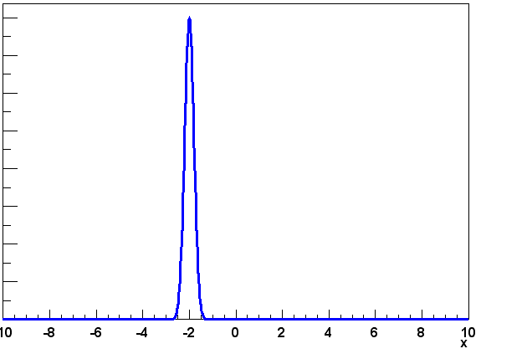
How does it work – toy event generation
Accept/reject method can be very inefficient
  Generating efficiency is
  Efficiency is very low for narrowly peaked functions
  Initial sampling for f_{max} requires very large trials sets
  in multiple dimension (~10000000 in 3D)
f_{max}
f(x)
x
Wouter Verkerke, NIKHEF

Slide 33
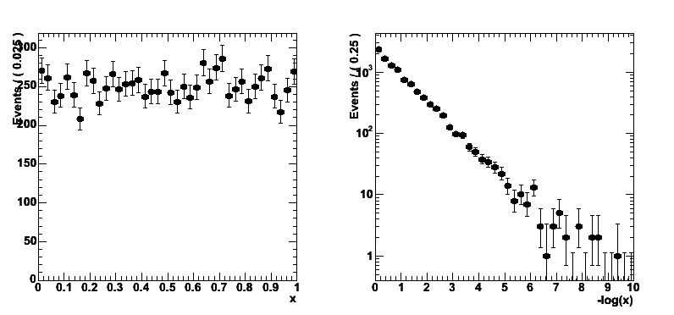
Toy MC generation – Inversion method
Analoguous to integration, p.d.f can advertise internal generator in case it can be done with a more efficient technique
E.g. function inversion
  Given f(x) find inverted function F(x)
  so that f( F(x) ) = x
  Throw uniform random number x
  Return F(x)
Maximally efficient, but only
works for class of p.d.f.s that
is invertible
x
Take –log(x)
Exponential
distribution
-ln(x)
Wouter Verkerke, NIKHEF

Slide 34
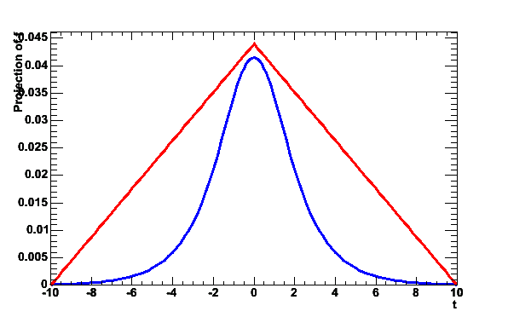
Toy MC generation – hybrid method
Hybrid technique of importance sampling applicable to larger class of p.d.f.s
  Find ‘envelope function’ g(x)
  that is invertible into G(x)
  and that fulfills g(x)>=f(x)
  for all x
  Generate random number x
  from G using inversion method
  Throw random number ‘y’
  If y<f(x)/g(x) keep x,
  otherwise return to step 2
  PRO: Faster than plain accept/reject sampling
  Function does not need to be invertible
  CON: Must be able to find invertible envelope function
g(x)
y
f(x)
G(x)
Wouter Verkerke, NIKHEF

Slide 35
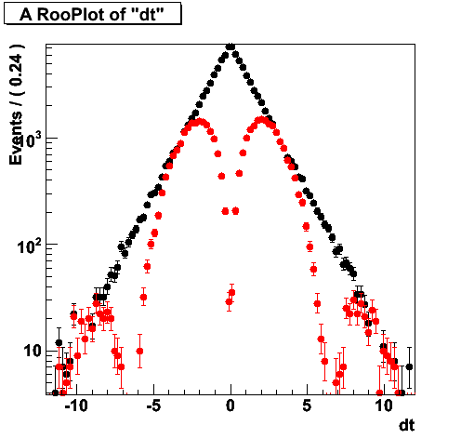
Toy MC generation – A peek inside RooBMixDecay
void RooBMixDecay::generateEvent(Int_t code) {
while(1) {
// Exponential decay envelope function through inversion
Double_t rand = RooRandom::uniform() ;
Double_t tval = -_tau*log(rand);
// Importance sampling of envelope
Double_t dil = 1-2.*mistag ;
Double_t maxAcceptProb = 1 + TMath::Abs(delMistag) + TMath::Abs(dil) ;
Double_t acceptProb = (1-tagFlav*delMistag) + _mixState*dil*cos(dm*tval);
Bool_t mixAccept = maxAcceptProb*RooRandom::uniform() < acceptProb ? kTRUE : kFALSE ;
// Accept event if t is in generated range
if (tval<_t.max() && tval>_t.min() && mixAccept) {
_t = tval ;
break ;
}
}
}
Wouter Verkerke, NIKHEF

Slide 36
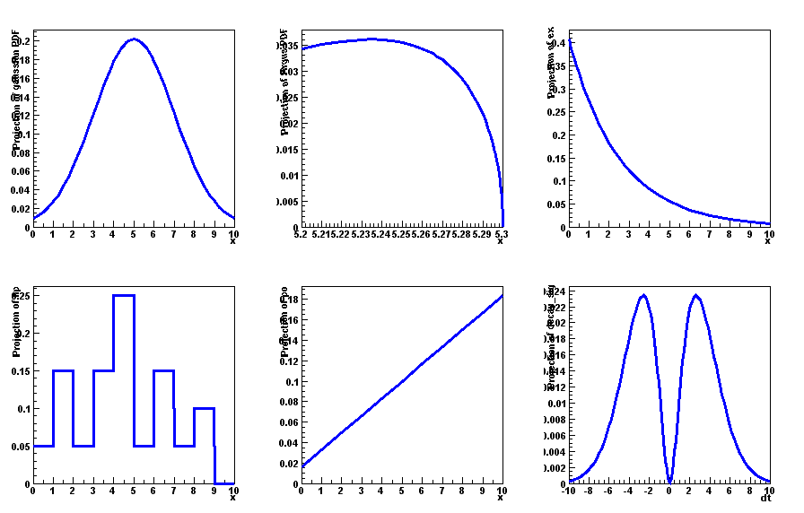
Model building – (Re)using standard components
RooFit provides a collection of compiled standard PDF classes
RooBMixDecay
Physics inspired
ARGUS,Crystal Ball,
Breit-Wigner, Voigtian,
B/D-Decay,….
RooPolynomial
RooHistPdf
RooArgusBG
Non-parametric
Histogram, KEYS
RooGaussian
Basic
Gaussian, Exponential, Polynomial,…
Chebychev polynomial
Easy to extend the library: each p.d.f. is a separate C++ class
Wouter Verkerke, NIKHEF

Slide 37
Model building – Generic expression-based PDFs
If your favorite PDF isn’t there
and you don’t want to code a PDF class right away
→ use RooGenericPdf
Just write down the PDFs expression as a C++ formula
Numeric normalization automatically provided
// PDF variables
RooRealVar x(“x”,”x”,-10,10) ;
RooRealVar y(“y”,”y”,0,5) ;
RooRealVar a(“a”,”a”,3.0) ;
RooRealVar b(“b”,”b”,-2.0) ;
// Generic PDF
RooGenericPdf gp(“gp”,”Generic PDF”,”exp(x*y+a)-b*x”,
RooArgSet(x,y,a,b)) ;
Wouter Verkerke, NIKHEF

Slide 38
Model Building – Writing your own class
Factory class exists (RooClassFactory) that can write, compile, link C++ code for RooFit p.d.f. and function classes
Example 1:
  Write class MyPdf with variable x,y,a,b in files MyPdf.h, MyPdf.cxx
  Only need to fill evaluate() method in MyPdf.cxx in terms of a,b,x
  Can add optional code to support for analytical integration, internal event generation
RooClassFactory::makePdf(“MyPdf”,”x,y,a,b”);
Wouter Verkerke, NIKHEF

Slide 39
Model Building – Writing your own class
Example 2:
  Functional equivalent to RooGenericPdf: Write class MyPdf with prefilled one-line function expression, compile and link p.d.f, create and return instance of class
Compiled code
RooAbsPdf* gp = RooClassFactory::makePdfInstance(“gp”,
”exp(x*y+a)-b*x”,RooArgSet(x,y,a,b));
Interpreted code
RooGenericPdf gp(“gp”,”Generic PDF”,”exp(x*y+a)-b*x”,
RooArgSet(x,y,a,b)) ;
Wouter Verkerke, NIKHEF

Slide 40
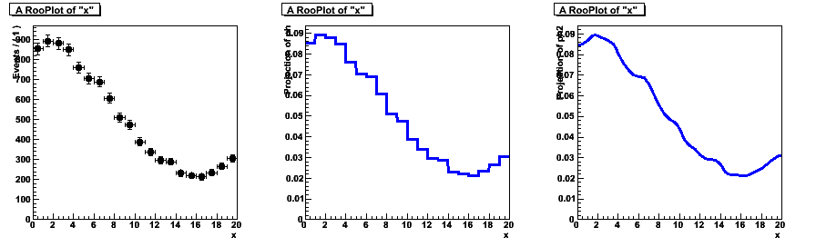
Highlight of non-parametric shapes - histograms
Will highlight two types of non-parametric p.d.f.s
Class RooHistPdf – a p.d.f. described by a histogram
  Not so great at low statistics (especially problematic in >1 dim)
dataHist
RooHistPdf(N=0)
RooHistPdf(N=4)
// Histogram based p.d.f with N-th order interpolation
RooHistPdf ph("ph","ph",x,*dataHist,N) ;
Wouter Verkerke, NIKHEF

Slide 41
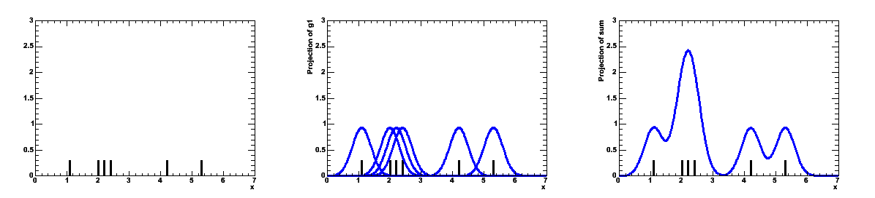
Highlight of non-parametric shapes – kernel estimation
Class RooKeysPdf – A kernel estimation p.d.f.
  Uses unbinned data
  Idea represent each event of your MC sample as a Gaussian probability distribution
  Add probability distributions from all events in sample
Gaussian
probability distributions
for each event
Summed
probability distribution
for all events in sample
Sample of events
Wouter Verkerke, NIKHEF

Slide 42
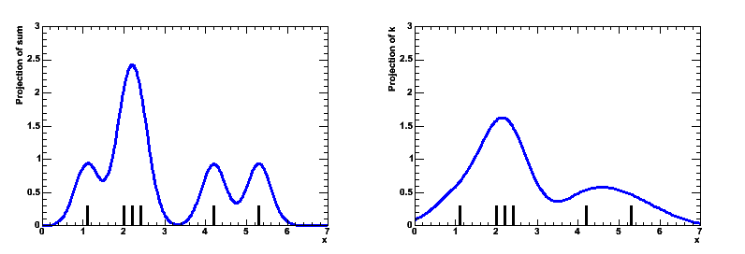
Highlight of non-parametric shapes – kernel estimation
Width of Gaussian kernels need not be the same for all events
  As long as each event contributes 1/N to the integral
Idea: ‘Adaptive kernel’ technique
  Choose wide Gaussian if local density of events is low
  Choose narrow Gaussian if local density of events is high
  Preserves small features in high statistics areas, minimize jitter in low statistics areas
  Automatically calculated
Static Kernel
(with of all Gaussian identical)
Adaptive Kernel
(width of all Gaussian depends
on local density of events)
Wouter Verkerke, NIKHEF

Slide 43
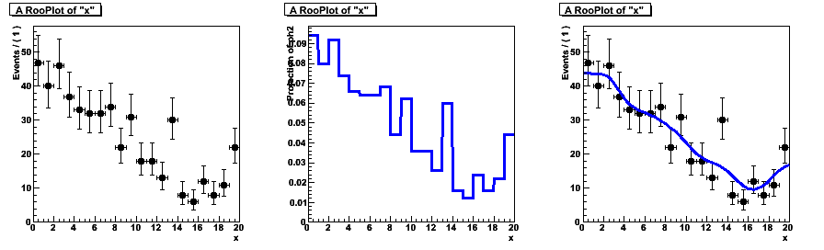
Highlight of non-parametric shapes – kernel estimation
Example with comparison to histogram based p.d.f
  Superior performance at low statistics
  Can mirror input data over boundaries to reduce ‘edge leakage’
  Works also in >1 dimensions (class RooNDKeysPdf)
// Adaptive kernel estimation p.d.f
RooKeysPdf k("k","k",x,*d,RooKeysPdf::MirrorBoth) ;
Data (N=500)
RooHistPdf(data)
RooKeysPdf(data)
Wouter Verkerke, NIKHEF

Slide 44
3
P.d.f. addition &
convolution
Using the addition operator p.d.f
Using the convolution operator p.d.f.
Wouter Verkerke, NIKHEF

Slide 45
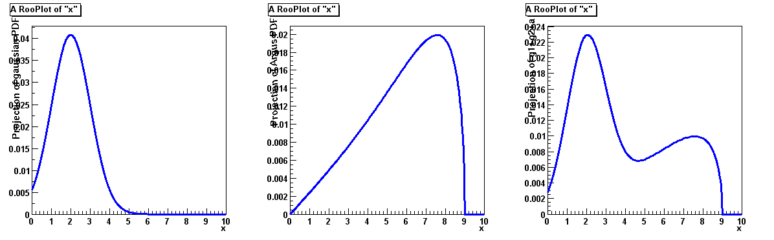
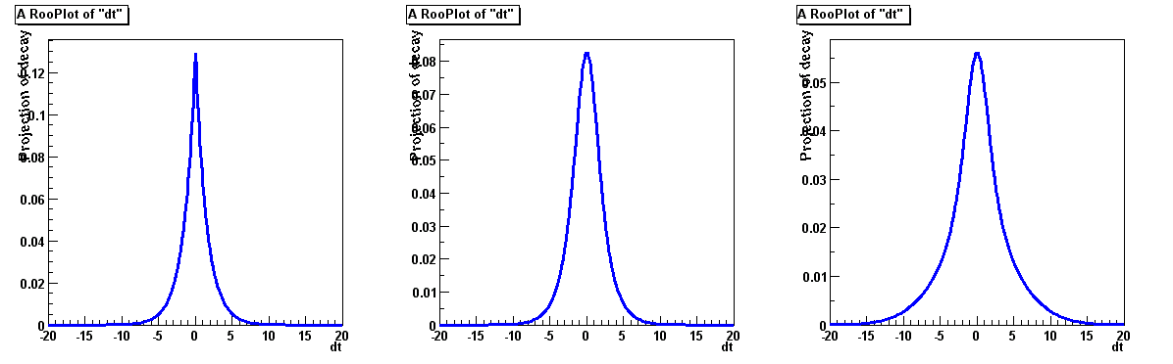
Building realistic models
Complex PDFs be can be trivially composed using operator classes
  Addition
  Convolution
+
=
⊗
=
Wouter Verkerke, NIKHEF

Slide 46
Model building – (Re)using standard components
Most realistic models are constructed as the sum of one or more p.d.f.s (e.g. signal and background)
Facilitated through operator p.d.f RooAddPdf
RooBMixDecay
RooPolynomial
RooHistPdf
RooArgusBG
RooGaussian
+
RooAddPdf
Wouter Verkerke, NIKHEF

Slide 47

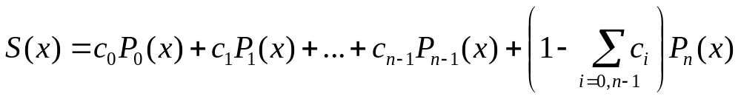
Adding p.d.f.s – Mathematical side
From math point of view adding p.d.f is simple
  Two components F, G
  Generically for N components P₀-P_{N}
For N p.d.f.s, there are N-1 fraction coefficients that should sum to less 1
  The remainder is by construction 1 minus the sum of all other coefficients
Wouter Verkerke, NIKHEF

Slide 48
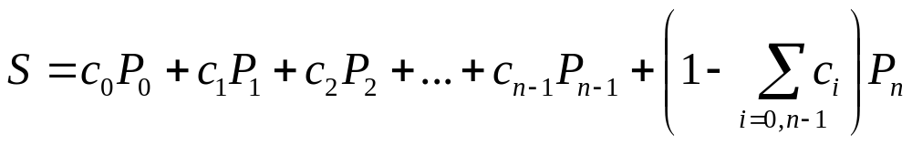
Constructing a sum of p.d.f.s
RooAddPdf constructs the sum of N PDFs with N-1 coefficients:
// Build two Gaussian PDFs
RooRealVar x("x","x",0,10) ;
RooRealVar mean1("mean1","mean of gaussian 1",2) ;
RooRealVar mean2("mean2","mean of gaussian 2",3) ;
RooRealVar sigma("sigma","width of gaussians",1) ;
RooGaussian gauss1("gauss1","gaussian PDF",x,mean1,sigma) ;
RooGaussian gauss2("gauss2","gaussian PDF",x,mean2,sigma) ;
// Build Argus background PDF
RooRealVar argpar("argpar","argus shape parameter",-1.0) ;
RooRealVar cutoff("cutoff","argus cutoff",9.0) ;
RooArgusBG argus("argus","Argus PDF",x,cutoff,argpar) ;
// Add the components
RooRealVar g1frac("g1frac","fraction of gauss1",0.5) ;
RooRealVar g2frac("g2frac","fraction of gauss2",0.1) ;
RooAddPdf sum("sum","g1+g2+a",RooArgList(gauss1,gauss2,argus),
RooArgList(g1frac,g2frac)) ;
Build 2
Gaussian
PDFs
Build
ArgusBG
PDF
List of PDFs
List of coefficients
Wouter Verkerke, NIKHEF

Slide 49
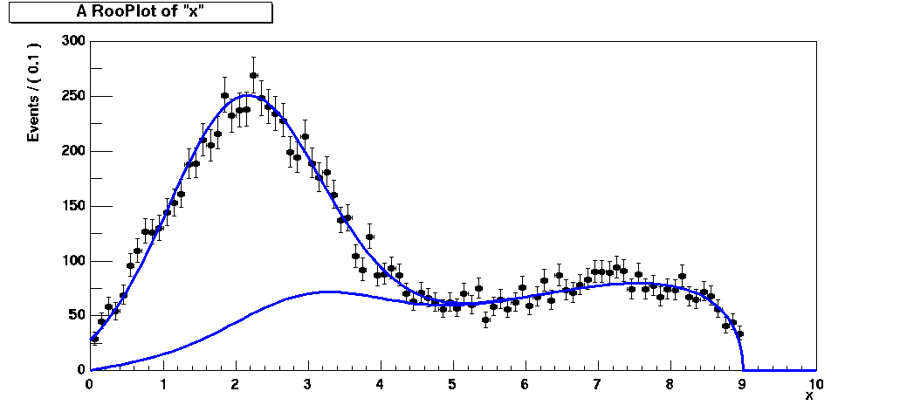
Plotting a sum of p.d.f.s, and its components
// Generate a toyMC sample
RooDataSet *data =
sum.generate(x,10000) ;
// Plot data and PDF overlaid
RooPlot* xframe = x.frame() ;
data->plotOn(xframe) ;
sum->plotOn(xframe) ;
// Plot only argus and gauss2
sum->plotOn(xframe,Components(RooArgSet(argus,gauss2))) ;
xframe->Draw() ;
Plot selected
components
of a RooAddPdf
Wouter Verkerke, NIKHEF

Slide 50
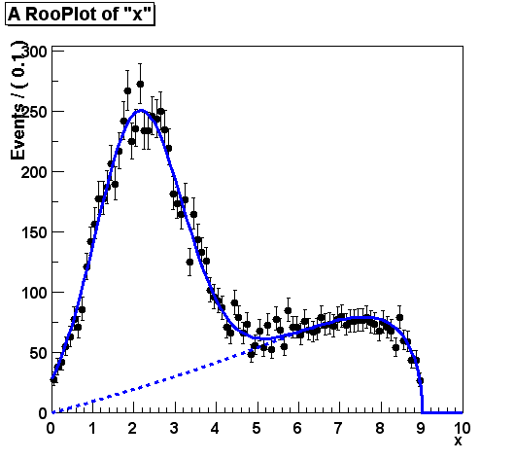
Component plotting - Introduction
Also special tools for plotting of components in RooPlots
  Use Method Components()
Example:
Argus + Gaussian PDF
// Plot data and full PDF first
// Now plot only argus component
sum->plotOn(xframe,
Components(argus), LineStyle(kDashed)) ;
Wouter Verkerke, NIKHEF

Slide 51
Component plotting – Selecting components
There are various ways to select single or multiple components to plot
Can refer to components either by name or reference
// Single component selection
pdf->plotOn(frame,Components(argus)) ;
pdf->plotOn(frame,Components(”gauss”)) ;
// Multiple component selection
pdf->plotOn(frame,Components(RooArgSet(pdfA,pdfB))) ;
pdf->plotOn(frame,Components(”pdfA,pdfB”)) ;
// Wild card expression allowed
pdf->plotOn(frame,Components(”bkgA*,bkgB*”)) ;
Wouter Verkerke, NIKHEF

Slide 52
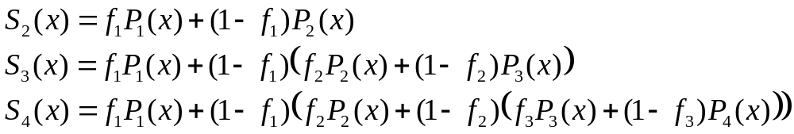
Recursive fraction form of RooAddPdf
Fitting a sum of >2 p.d.f.s can pose some problems as the sum of the coefficients f₁…f_{N-1} may become >1
  This results in a negative remainder component (≡1-Σ_{i}f_{i})
  Composite p.d.f may still be positive definite, but interpretation less clear
  Could set limits on fractions f_{i} to avoid Σf_{i}>1 scenario, but where to put limits?
Viable alternative to write as sum of recursive fractions
// Add the components with recursive fractions
RooAddPdf sum("sum",“fA*a+(fG*g1+g2)",RooArgList(a,g1,g2),
RooArgList(afrac,gfrac),kTRUE) ;
Wouter Verkerke, NIKHEF

Slide 53
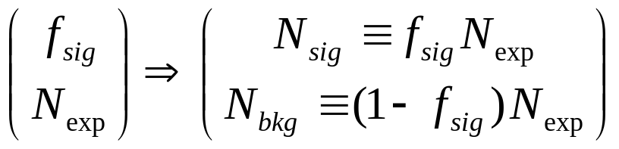
Extended p.d.f form of RooAddPdf
If extended ML term is introduced, we can fit expected number of events (N_{exp}) in addition to shape parameters
In case of sum of p.d.f.s it is convenient to re-parameterize sum of p.d.f.s.
This transformation is applied automatically in RooAddPdf if equal number of p.d.f.s and coefs are given
RooRealVar nsig(“nsig”,”number of signal events”,100,0,10000) ;
RooRealVar nbkg(“nbkg”,”number of backgnd events”,100,0,10000) ;
RooAddPdf sume(“sume”,”extended sum pdf”,RooArgList(gauss,argus),
RooArgList(nsig,nbkg)) ;
Wouter Verkerke, NIKHEF

Slide 54
General features of extended p.d.f.s
Extended term –log(Poisson(N_{obs},N_{exp})) is not added by default to likelihood
  Use the Extended() argument to fit to have it added
If p.d.f. is extended, N_{exp} is default number of events to generate
// Regular maximum likelihood fit
pdf.fitTo(*data) ;
// Extended maximum likelihood fit
pdf.fitTo(*data,Extended(kTRUE)) ;
// Generate pdf.expectedEvents() events
RooDataSet* data = pdf.generate(x) ;
// Generate 1000 events
RooDataSet* data = pdf.generate(x,1000) ;
Wouter Verkerke, NIKHEF

Slide 55
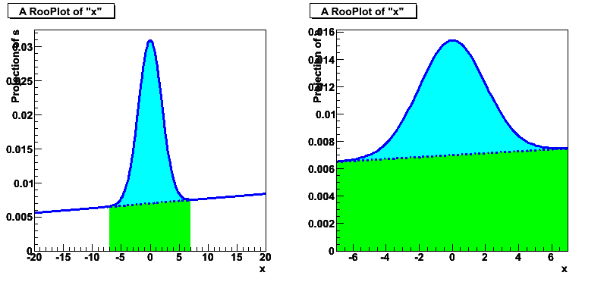
How it works – Normalization of RooAddPdfs
Since all component p.d.f.s are normalized, resulting sum of p.d.f.s is automatically normalized
  As long as sum of coefficients is 1, which is automatically enforced
  But note that fraction parameter multiplies normalized p.d.f.s
Interpretation of fraction depends on range of observables (and number of observables for >1D)
  If range of observable is changed
  and fraction parameter is same,
  the shape effectively different
  Can mitigate this by specifying
  a fixed reference range for
  fraction interpretation
x.setRange(“ref”,-20,20) ;
pdf->setAddCoefRange(“ref”) ;
Wouter Verkerke, NIKHEF

Slide 56

How it works – event generation of RooAddPdf
Composite event generation algoritm of RooAddPdf
  Choose randomly a component to generate
  (probability proportional to coefficient fractions)
  Delegate generation of observable to algorithm of component p.d.f.
Allows to efficiently handle sum of p.d.f with very different shapes in most cases
  Example:
  Blue Gaussian
  (internal generator)
  plus Green Polynomial
  (accept/reject)
Wouter Verkerke, NIKHEF

Slide 57
Dealing with composite p.d.f.s
A RooAddPdf is an example of a composite p.d.f
  The value of the sum is represented by a tree of components
  The compositeness of a p.d.f. is completely transparent to most high-level operations
  Can e.g. do sum->fitTo(*data) or sum->generate(x,1000) without being aware of composite nature of p.d.f.
RooAddPdf
sum
RooGaussian
gauss1
RooRealVar
g1frac
RooGaussian
gauss2
RooRealVar
g2frac
RooArgusBG
argus
RooRealVar
mean1
RooRealVar
sigma
RooRealVar
x
RooRealVar
mean2
RooRealVar
argpar
RooRealVar
cutoff
Wouter Verkerke, NIKHEF

Slide 58
Dealing with composite p.d.f.s
The observables reported by a composite p.d.f and the ‘leaf’ of the expression tree
  For example, request for list of parameters of composite sum, will return parameters of components of sum
In general, composite p.d.f.s work exactly the same as basic p.d.f.s.
RooArgSet *paramList = sum.getParameters(data) ;
paramList->Print("v") ;
RooArgSet::parameters:
1) RooRealVar::argpar : -1.00000 C
2) RooRealVar::cutoff : 9.0000 C
3) RooRealVar::g1frac : 0.50000 C
4) RooRealVar::g2frac : 0.10000 C
5) RooRealVar::mean1 : 2.0000 C
6) RooRealVar::mean2 : 3.0000 C
7) RooRealVar::sigma : 1.0000 C
Wouter Verkerke, NIKHEF

Slide 59
Visualization tools for composite objects
Special tools exist to visualize the tree structure of composite objects
  On the command line
Root> sum.Print(“t”) ;
0x927b8d0 RooAddPdf::sum (g1+g2+a) [Auto]
0x9254008 RooGaussian::gauss1 (gaussian PDF) [Auto] V
0x9249360 RooRealVar::x (x) V
0x924a080 RooRealVar::mean1 (mean of gaussian 1) V
0x924d2d0 RooRealVar::sigma (width of gaussians) V
0x9267b70 RooRealVar::g1frac (fraction of gauss1) V
0x9259dc0 RooGaussian::gauss2 (gaussian PDF) [Auto] V
0x9249360 RooRealVar::x (x) V
0x924cde0 RooRealVar::mean2 (mean of gaussian 2) V
0x924d2d0 RooRealVar::sigma (width of gaussians) V
0x92680e8 RooRealVar::g2frac (fraction of gauss2) V
0x9261760 RooArgusBG::argus (Argus PDF) [Auto] V
0x9249360 RooRealVar::x (x) V
0x925fe80 RooRealVar::cutoff (argus cutoff) V
0x925f900 RooRealVar::argpar (argus shape parameter) V
0x9267288 RooConstVar::0.500000 (0.500000) V
Wouter Verkerke, NIKHEF

Slide 60


Visualization tools for composite objects
Interface to GraphViz graph visualization tool
‘fdp –Tgif sum.dot
–o sum.gif’
Root> sum.graphVizTree(“sum.dot”)
‘dot –Tgif sum.dot
–o sum.gif’
Wouter Verkerke, NIKHEF

Slide 61

Putting it all together – Extended unbinned ML Fit to signal and background
// Declare observable x
RooRealVar x("x","x",0,10) ;
// Creation of ‘sig’, ‘bkg’ component p.d.f.s omitted for clarity
// Model = Nsig*sig + Nbkg*bkg (extended form)
RooRealVar nsig("nsig","#signal events",300,0.,2000.) ;
RooRealVar nbkg("nbkg","#background events",700,0,2000.) ;
RooAddPdf model("model","sig+bkg",RooArgList(sig,bkg),RooArgList(nsig,nbkg)) ;
// Generate a data sample of Nexpected events
RooDataSet *data = model.generate(x) ;
// Fit model to data
model.fitTo(*data, Extended(kTRUE)) ;
// Plot data and PDF overlaid
RooPlot* xframe = x.frame() ;
data->plotOn(xframe) ;
model.plotOn(xframe) ;
model.plotOn(xframe,Components(bkg),
LineStyle(kDashed)) ;
xframe->Draw() ;
Wouter Verkerke, NIKHEF

Slide 62
Building models – Convolutions
Many experimental observable quantities are well described by convolutions
  Typically physics distribution smeared with experimental resolution (e.g. for B0 → J/ψ K_{S} exponential decay distribution smeared with Gaussian)
  By explicitly describing observed distribution with a convolution p.d.f can disentangle detector and physics
    To the extent that enough information is in the data to make this possible
⊗
=
Wouter Verkerke, NIKHEF

Slide 63


Mathematical introduction & Numeric issues
Mathematical form of convolution
  Convolution of two functions
  Convolution of two normalized p.d.f.s itself is not automatically normalized, so expression for convolution p.d.f is
  Because of (multiple) integrations required convolution are difficult to calculate
  Convolution integrals are best done analytically, but often not possible
Wouter Verkerke, NIKHEF

Slide 64

Convolution operation in RooFit
RooFit has several options to construct convolution p.d.f.s
  Class RooNumConvPdf – ‘Brute force’ numeric calculation of convolution (and normalization integrals)
  Class RooFFTConvPdf – Calculate convolution integral using discrete FFT technology in fourier-transformed space.
  Bases classes RooAbsAnaConvPdf, RooResolutionModel. Framework to construct analytical convolutions (with implementations mostly for B physics)
  Class RooVoigtian – Analytical convolution of
  non-relativistic Breit-Wigner shape with a Gaussian
All convolution in one dimension so far
  N-dim extension of RooFFTConvPdf foreseen in future
Wouter Verkerke, NIKHEF

Slide 65

Numeric convolutions – Class RooNumConvPdf
Properties of RooNumConvPdf
  Can convolve any two input p.d.f.s
  Uses special numeric integrator that can compute integrals in
  [-∞,+∞] domain
  Slow (very!) especially if requiring sufficient numeric precision to allow use in MINUIT (requires ~10⁻⁷ estimated precision). Converge problems in MINUIT if precision is insufficient
// Construct landau (x) gauss
RooNumConvPdf lxg("lxg","landau (X) gauss",t,landau,gauss) ;
Landau
Gauss
Landau ⊗ Gauss
Wouter Verkerke, NIKHEF

Slide 66



Numeric convolutions – Class RooFFTConvPdf
Properties of RooFFTConvPdf
  Uses convolution theorem to compute discrete convolution in Fourier-Transformed space.
  Transforms both input p.d.f.s with forward FFT
  Makes use of Circular Convolution Theorem in Fourier Space
  Convolution can be computed in terms of products of Fourier components (easy)
  Apply inverse Fourier transform to obtained convoluted p.d.f in space domain
(x_{i} are sampled values of p.d.f)
Wouter Verkerke, NIKHEF

Slide 67
Numeric convolutions – Class RooFFTConvPdf
Fourier transforms calculated by FFTW3 package
  Interfaced in ROOT through TVirtualFFT class
About 100x faster than RooNumConvPdf
  Also much better numeric stability (c.f. MINUIT converge)
  Choose sufficiently large number of samplings to obtain
  smooth output p.d.f
  CPU time is not proportional to number of samples,
  e.g. 10000 bins works fine in practice
Note: p.d.f.s are not sampled from [-∞,+∞], but from [x_{min},x_{max}]
Note: p.d.f is explicitly treated as cyclical beyond range
  Excellent for cyclical observables such as angles
  If p.d.f converges to zero towards both ends of range if non-cyclical observable, all works out fine
  If p.d.f does not converge to zero towards domain end, cyclical leakage will occur
Wouter Verkerke, NIKHEF

Slide 68

Numeric convolutions – Class RooFFTConvPdf
Usage example
Example with cyclical ‘leakage’
  Can reduce this by specifying a
  ‘buffer zone’ in FFT calculation
  beyond end of ranges
  conv.setBufferFraction(0.3)
// Construct landau (x) gauss (10000 samplings 2nd order interpolation)
t.setBins(10000,”cache”) ;
RooFFTConvPdf lxg("lxg","landau (X) gauss",t,landau,gauss,2) ;
Wouter Verkerke, NIKHEF

Slide 69


Framework for analytical calculations of convolutions
demo6.cc
Convoluted PDFs that can be written if the following form can be used in a very modular way in RooFit
‘basis function’
coefficient
resolution function
Example: B⁰ decay with mixing
Wouter Verkerke, NIKHEF

Slide 70

Convoluted PDFs
Physics model and resolution model are implemented separately in RooFit
Implements
Also a PDF by itself
RooResolutionModel
RooConvolutedPdf (physics model)
Implements c_{k}
Declares list of f_{k} needed
User can choose combination of physics model
and resolution model at run time
(Provided resolution model implements all f_{k} declared by physics model)
Wouter Verkerke, NIKHEF

Slide 71

Convoluted PDFs
RooRealVar dt("dt","dt",-10,10) ;
RooRealVar tau("tau","tau",1.548) ;
// Truth resolution model
RooTruthModel tm("tm","truth model",dt) ;
// Unsmeared decay PDF
RooDecay decay_tm("decay_tm","decay",
dt,tau,tm,RooDecay::DoubleSided) ;
// Gaussian resolution model
RooRealVar bias1("bias1","bias1",0) ;
RooRealVar sigma1("sigma1","sigma1",1) ;
RooGaussModel gm1("gm1","gauss model",
dt,bias1,sigma1) ;
// Construct a decay (x) gauss PDF
RooDecay decay_gm1("decay_gm1","decay",
dt,tau,gm1,RooDecay::DoubleSided) ;
decay
decay ⊗ gm1
Wouter Verkerke, NIKHEF

Slide 72
Composite Resolution Models: RooAddModel
//... (continued from last page)
// Wide gaussian resolution model
RooRealVar bias2("bias2","bias2",0) ;
RooRealVar sigma2("sigma2","sigma2",5) ;
RooGaussModel gm2("gm2","gauss model 2“
,dt,bias2,sigma2) ;
// Build a composite resolution model
RooRealVar f(“f","fraction of gm1",0.5) ;
RooAddModel gmsum("gmsum",“gm1+gm2",
RooArgList(gm1,gm2),f) ;
// decay (x) (gm1 + gm2)
RooDecay decay_gmsum("decay_gmsum",
"decay",dt,tau,gmsum,
RooDecay::DoubleSided) ;
decay ⊗ gm1
decay ⊗ (f⋅gm1+(1-f)⋅gm2)
→RooAddModel works like RooAddPdf
Wouter Verkerke, NIKHEF

Slide 73

Resolution models
Currently available resolution models
  RooGaussModel – Gaussian with bias and sigma
  RooGExpModel – Gaussian (X) Exp with sigma and lifetime
  RooTruthModel – Delta function
A RooResolutionModel is also a PDF
  You can use the same resolution model
  you use to convolve your physics PDFs to fit to MC residuals
physics
res.model
⊗
=
Wouter Verkerke, NIKHEF

Slide 74

How it works – generating events from convolution p.d.f.s
A very efficient implementation of event generation is possible
  Reflect ‘smearing’ view of convolution
  Very fast as no computation of convolution integrals is required
  But only if both input p.d.f.s can generate observables in the range [-∞,+∞] which is not possible with accept/reject so this can only be done if both input p.d.f.s have an internal generator implementation
  If above conditions are not met, automatic fallback solution is to perform accept/reject sampling on convoluted p.d.f. shape
Wouter Verkerke, NIKHEF

Slide 75
4
Multidimensional
models
Uncorrelated products of p.d.f.s
Using composition to p.d.f.s with correlation
Products of conditional and plain p.d.f.s
Wouter Verkerke, NIKHEF

Slide 76


Building realistic models
  Multiplication
  Composition
*
=
=
m(y;a₀,a₁)
g(x;m,s)
g(x,y;a0,a1,s)
Possible in any PDF
No explicit support in PDF code needed
Wouter Verkerke, NIKHEF

Slide 77

Model building – Products of uncorrelated p.d.f.s
RooBMixDecay
RooPolynomial
RooHistPdf
RooArgusBG
RooGaussian
*
RooProdPdf
Wouter Verkerke, NIKHEF

Slide 78

Uncorrelated products – Mathematics and constructors
Mathematical construction of products of uncorrelated p.d.f.s is straightforward
  No explicit normalization required → If input p.d.f.s are unit normalized, product is also unit normalized
  (this is true only because of the absence of correlations)
Corresponding RooFit operator p.d.f. is RooProdPdf
  Returns product of normalized input p.d.f values
2D
nD
RooGaussian gx("gx","gaussian PDF",x,meanx,sigmax) ;
RooGaussian gy("gy","gaussian PDF",y,meany,sigmay) ;
// Multiply gaussx and gaussy into a two-dimensional p.d.f. gaussxy
RooProdPdf gaussxy("gxy","gx*gy",RooArgList(gx,gy)) ;
Wouter Verkerke, NIKHEF

Slide 79

How it work – event generation on uncorrelated products
If p.d.f.s are uncorrelated, each observable can be generated separately
  Reduced dimensionality of problem (important for e.g. accept/reject sampling)
  Actual event generation delegated to component p.d.f (can e.g. use internal generator if available)
  RooProdPdf just aggregates output in single dataset
Delegate
Generate
Merge
Wouter Verkerke, NIKHEF

Slide 80

Fundamental multi-dimensional p.d.fs
It also possible define multi-dimensional p.d.f.s that do not arise through a product construction
  For example
  But usually n-dim p.d.f.s are constructed more intuitively through product constructs. Also correlations can be introduced efficiently (more on that in a moment)
Example of fundamental 2-D
B-physics p.d.f. RooBMixDecay
  Two observables:
  decay time (t, continuous)
  mixingState (m, discrete [-1,+1])
RooGenericPdf gp(“gp”,”sqrt(x+y)*sqrt(x-y)”,RooArSet(x,y)) ;
mixing state
decay time
Wouter Verkerke, NIKHEF

Slide 81



Plotting multi-dimensional PDFs
RooPlot* xframe = x.frame() ;
data->plotOn(xframe) ;
prod->plotOn(xframe) ;
xframe->Draw() ;
c->cd(2) ;
RooPlot* yframe = y.frame() ;
data->plotOn(yframe) ;
prod->plotOn(yframe) ;
yframe->Draw() ;
-Plotting a dataset D(x,y) versus x
represents a projection over y
-To overlay PDF(x,y),
you must plot Int(dy)PDF(x,y)
RooFit automatically takes care of this!
  RooPlot remembers dimensions of plotted datasets
Wouter Verkerke, NIKHEF

Slide 82


Projecting out hidden dimensions
Example in 2 dimensions
  2-dim dataset D(x,y)
  2-dim PDF P(x,y)=gauss(x)*gauss(y)
1-dim plot versus x
1-dim plot versus y
Wouter Verkerke, NIKHEF

Slide 83


RooProdPdf automatic optimization for uncorrelated terms
Example in 2 dimensions
  2-dim dataset D(x,y)
  2-dim PDF P(x,y)=gaus(x)*gauss(y)
1-dim plot versus x
1-dim plot versus y
Wouter Verkerke, NIKHEF

Slide 84
Introduction to slicing
With multidimensional p.d.f.s it is also often useful to be able to plot a slice of a p.d.f
In RooFit
  A slice is thin
  A range is thick
Slices mostly useful
in discrete observables
  A slice in a continuous observable
  has no width and usually no data
  with the corresponding cut
  (e.g. “x=5.234”)
Ranges work for both
continuous and discrete
observables
  Range of discrete observable
  can be list of >=1 state
Slice in x
x = x.getVal()
Range in y
Wouter Verkerke, NIKHEF

Slide 85

Plotting a slice of a dataset
Use the optional cut string expression
  Works the same for binned data sets
// Mixing dataset defines dt,mixState
RooDataSet* data ;
// Plot the entire dataset
RooPlot* frame = dt.frame() ;
data->plotOn(frame) ;
// Plot the mixed part of the data
RooPlot* frame_mix = dt.frame() ;
data->plotOn(frame,
Cut(”mixState==mixState::mixed”)) ;
Wouter Verkerke, NIKHEF

Slide 86


Plotting a slice of a p.d.f
RooPlot* dtframe = dt.frame() ;
data->plotOn(dtframe,Cut(“mixState==mixState::mixed“)) ;
mixState = "mixed" ;
bmix.plotOn(dtframe,Slice(mixState)) ;
dtframe->Draw() ;
Slice is positioned at ‘current’ value of sliced observable
For slices both data and p.d.f normalize with respect to full dataset. If fraction ‘mixed’ in above example disagrees between data and p.d.f prediction, this discrepancy will show in plot
Wouter Verkerke, NIKHEF

Slide 87

Plotting a range of a p.d.f and a dataset
model(x,y) = gauss(x)*gauss(y) + poly(x)*poly(y)
RooPlot* xframe = x.frame() ;
data->plotOn(xframe) ;
model.plotOn(xframe) ;
y.setRange(“sig”,-1,1) ;
RooPlot* xframe2 = x.frame() ;
data->plotOn(xframe2,CutRange("sig")) ;
model.plotOn(xframe2,ProjectionRange("sig")) ;
→ Works also with >2D projections (just specify projection range on all projected observables)
→ Works also with multidimensional p.d.fs that have correlations
Wouter Verkerke, NIKHEF

Slide 88

Physics example of combined range and slice plotting
Example setup:
Argus(mB)*Decay(dt) +
Gauss(mB)*BMixDecay(dt)
(background)
(signal)
mB
// Plot projection on mB
RooPlot* mbframe = mb.frame(40) ;
data->plotOn(mbframe) ;
model.plotOn(mbframe) ;
// Plot mixed slice projection on deltat
RooPlot* dtframe = dt.frame(40) ;
data>plotOn(dtframe,
Cut(”mixState==mixState::mixed”)) ;
mixState=“mixed” ;
model.plotOn(dtframe,Slice(mixState)) ;
dt (mixed slice)
Wouter Verkerke, NIKHEF

Slide 89
Plotting slices with finite width - Example
“signal”
Example setup:
Argus(mB)*Decay(dt) +
Gauss(mB)*BMixDecay(dt)
(background)
(signal)
mB
dt (mixed slice)
mb.setRange(“signal”,5.27,5.30) ;
mbSliceData->plotOn(dtframe2,
Cut("mixState==mixState::mixed“),
CutRange(“signal”))
model.plotOn(dtframe2,Slice(mixState),
ProjectionRange(“signal”))
dt (mixed slice &&
“signal” range)
Wouter Verkerke, NIKHEF

Slide 90
Plotting slices with finite width - Example
We can also plot the finite width slice with a different technique → toy MC integration
// Generate 80K toy MC events from p.d.f to be projected
RooDataSet *toyMC =
model.generate(RooArgSet(dt,mixState,tagFlav,mB),80000);
// Apply desired cut on toy MC data
RooDataSet* mbSliceToyMC = toyMC->reduce(“mb>5.27”);
// Plot data requesting data averaging over selected toy MC data
model.plotOn(dtframe2,Slice(mixState),ProjWData(mb,mbSliceToyMC))
Wouter Verkerke, UCSB

Slide 91
Plotting non-rectangular PDF regions
Why is this interesting? Because with this technique we can trivially implement projection over arbitrarily shaped regions.
  Any cut prescription that you can think of to apply to data works
Example: Likelihood ratio projection plot
  Common technique in rare decay analyses
  PDF typically consist of N-dimensional event selection PDF,
  where N is large (e.g. 6.)
  Projection of data & PDF in any of the N dimensions doesn’t show a significant excess of signal events
  To demonstrate purity of selected signal,
  plot data distribution (with overlaid PDF) in one dimension,
  while selecting events with a cut on the likelihood ratio of signal and background in the remaining N-1 dimensions
Wouter Verkerke, NIKHEF

Slide 92

Plotting data & PDF with a likelihood ratio cut
Simple example
  3 observables (x,y,z)
  Signal shape: gauss(x)·gauss(y)·gauss(z)
  Background shape: (1+a·x)(1+b·y)(1+c·z)
  Plot distribution in x
// Plot x distribution of all events
RooPlot* xframe1 = x.frame(40) ;
data->plotOn(xframe1) ;
sum.plotOn(xframe1) ;
Integrated projection of data/PDF on
X doesn’t reflect signal/background
discrimination power of PDF in y,z
Use LR ratio technique to only plot
events with are signal-like according
to p.d.f in projected observable (y,z)
Wouter Verkerke, NIKHEF

Slide 93
Plotting data & PDF with a likelihood ratio cut
Given a p.d.f. with three observable (x,y,z)
how do you calculate the S’(y,z)/(S’(y,z)+B’(y,z)) L ratio
First calculate projected likelihoods S’ and B’
  Use the built-in createProjection method which returns a projection of a given p.d.f.s
The calculate ratio for each event
RooAbsPdf* sigYZ = sig->createProjection(x) ;
RooAbsPdf* totYZ = model->createProjection(x) ;
// Formula expression of LR
RooFormulaVar LR(“LR”,”-log(sigYZ)-(-log(totYZ)”,
RooArgSet(*sigYX,*totYZ)) ;
// Add column to dataset with precalculate value of LR
data->addColumn(LR) ;
Wouter Verkerke, NIKHEF

Slide 94
Plotting data & PDF with a likelihood cut
Look at distribution of per-event LR in toy MC sample and decide on suitable cut
Apply cut to both data sample and toyMC sample for projection and make plot
Wouter Verkerke, NIKHEF

Slide 95

Plotting in more than 2,3 dimensions
No equivalent of RooPlot for >1 dimensions
  Usually >1D plots are not overlaid anyway
Easy to use createHistogram() methods provided in both RooAbsData and RooAbsPdf to fill ROOT 2D,3D histograms
TH2D* ph2 = pdf.createHistogram(“ph2”,x,YVar(y)) ;
TH2* dh2 = data.createHistogram(“dg2",x,Binning(10),
YVar(y,Binning(10)));
ph2->Draw("SURF") ;
dh2->Draw("LEGO") ;
Wouter Verkerke, NIKHEF

Slide 96
Building models – Introducing correlations
Easiest way to do this is
  start with 1-dim p.d.f. and change on of its parameters into a function that depends on another observable
  Natural way to think about it
Example problem
  Observable is reconstructed mass M of some object.
  Fitting Gaussian g(M,mean,sigma) some background to dataset D(M)
  But reconstructed mass has bias depending on some other observable X
  Rewrite fit functions as g(M,meanCorr(mtrue,X,alpha),sigma)
  where meanCorr is an (emperical) function that corrects for the bias depending on X
Wouter Verkerke, NIKHEF

Slide 97
Coding the example problem
How do you code the preceding example problem
PDF(x,y) = gauss(x,m(y),s)
m(y) = m₀ + m₁⋅sqrt(y)
How do you do that? Just like that:
RooRealVar x("x","x",-10,10) ;
RooRealVar y("y","y",0,3) ;
// Build a parameterized mean variable for gauss
RooRealVar mean0("mean0",“mean offset",0.5) ;
RooRealVar mean1("mean1",“mean slope",3.0) ;
RooFormulaVar mean("mean","mean0+mean1*y",
RooArgList(mean0,mean1,y)) ;
RooRealVar sigma("sigma","width of gaussian",3) ;
RooGaussian gauss("gauss","gaussian",x,mean,sigma);
Build a function object
m(y)=m₀+m₁*sqrt(y)
Simply plug in
function mean(y)
where mean value
is expected!
Plug-and-play parameters!
PDF expects a real-valued object
as input, not necessarily a variable
Wouter Verkerke, NIKHEF
Notes:
Show that gauss is now a function of x,y,m0,m1,sigma

Slide 98
Generic real-valued functions
RooFormulaVar makes use of the ROOT TFormula technology to build interpreted functions
  Understands generic C++ expressions, operators etc
  Two ways to reference RooFit objects
  By name:
  By position:
  You can use RooFormulaVar where ever a ‘real’ variable is requested
RooPolyVar is a compiled polynomial function
RooFormulaVar f(“f”,”exp(foo)*sqrt(bar)”, RooArgList(foo,bar)) ;
RooFormulaVar f(“f”,”exp(@0)*sqrt(@1)”,RooArgList(foo,bar)) ;
RooRealVar x(“x”,”x”,0.,1.) ;
RooRealVar p0(“p0”,”p0”,5.0) ;
RooRealVar p1(“p1”,”p1”,-2.0) ;
RooRealVar p2(“p2”,”p2”,3.0) ;
RooFormulaVar f(“f”,”polynomial”,x,RooArgList(p0,p1,p2)) ;
Wouter Verkerke, NIKHEF

Slide 99

What does the example p.d.f look like?
Make 2D plot of p.d.f in (x,y)
Is the correct p.d.f for this problem?
  Constructed a p.d.f with correct shape in x, given a value of y → OK
  But p.d.f predicts flat distribution in y → Probably not OK
  What we want is a pdf for X given Y, but without prediction on Y → Definition of a conditional p.d.f F(x|y)
Projection on Y
Projection on X
Wouter Verkerke, NIKHEF

Slide 100

Conditional p.d.f.s – Formulation and construction
Mathematical formulation of a conditional p.d.f
  A conditional p.d.f is not normalized w.r.t its conditional observables
  Note that denominator in above expression depends on y and is thus in general different for each event
Constructing a conditional p.d.f in RooFit
  Any RooFit p.d.f can be used as a conditional p.d.f as objects have no internal notion of distinction between parameters, observables and conditional observables
  Observables that should be used as conditional observables have to be specified in use context (generation, plotting, fitting etc…)
Wouter Verkerke, NIKHEF

Slide 101



Using a conditional p.d.f – fitting and plotting
For fitting, indicate in fitTo() call what the conditional observables are
  You may notice a performance penalty if the normalization integral of the p.d.f needs to be calculated numerically.
  For a conditional p.d.f it must evaluated again for each event
Plotting: You cannot project a conditional F(x|y) on x without external information on the distribution of y
  Substitute integration with averaging over y values in data
pdf.fitTo(data,ConditionalObservables(y))
Integrate over y
Sum over all y_{i} in dataset D
Wouter Verkerke, NIKHEF

Slide 102


Physics example with conditional p.d.f.s
Want to fit decay time distribution of B0 mesons (exponential) convoluted with Gaussian resolution
However, resolution on decay time varies from event by event (e.g. more or less tracks available).
  We have in the data an error estimate dt for each measurement from the decay vertex fitter (“per-event error”)
  Incorporate this information into this physics model
  Resolution in physics model is adjusted for each event to expected error.
  Overall scale factor σ can account for incorrect vertex error estimates (i.e. if fitted σ>1 then dt was underestimate of true error)
  Physics p.d.f must used conditional conditional p.d.f because it give no sensible prediction on the distribution of the per-event errors
Wouter Verkerke, NIKHEF

Slide 103

Physics example with conditional p.d.f.s
Some illustrations of decay model with per-event errors
  Shape of F(t|δt) for several values of δt
Plot of D(t) and F(t|dt) projected over dt
Small dt
Large dt
// Plotting of decay(t|dterr)
RooPlot* frame = dt.frame() ;
data->plotOn(frame2) ;
decay_gm1.plotOn(frame2,ProjWData(*data)) ;
Note that projecting over large
datasets can be slow. You can speed
this up by projecting with a binned
copy of the projection data
Wouter Verkerke, NIKHEF

Slide 104
How it works – event generation with conditional p.d.f.s
Just like plotting, event generation of conditional p.d.f.s requires external input on the conditional observables
  Given an external input dataset P(dt)
  For each event in P,
  set the value of dt in F(d|dt) to dt_{i}
  generate one event for observable t from F(t|dt_{i})
  Store both t_{i} and dt_{i} in the output dataset
Wouter Verkerke, NIKHEF

Slide 105
Complete example of decay with per-event errors
RooRealVar dt("dt","dt",-10,10) ;
RooRealVar dterr("dterr","dterr",0.001,5) ;
RooRealVar tau("tau","tau",1.548) ;
// Build Gauss(dt,0,sigma*dterr)
RooRealVar sigma("sigma","sigma1",1) ;
RooGaussModel gm1("gm1","gauss model 1",dt,RooConst(0),sigma,dterr) ;
// Construct decay(t,tau) (x) gauss1(t,0,sigma*dterr)
RooDecay decay_gm1("decay_gm1","decay",dt,tau,gm1,RooDecay::DoubleSided) ;
// Toy MC generation of decay(t|dterr)
RooDataSet* toydata = decay_gm1.generate(dt,ProtoData(dterrData)) ;
// Fitting of decay(t|dterr)
decay_gm1.fitTo(*data,ConditionalObservables(dterr))
// Plotting of decay(t|dterr)
RooPlot* frame = dt.frame() ;
data->plotOn(frame2) ;
decay_gm1.plotOn(frame2,ProjWData(*data)) ;
Wouter Verkerke, NIKHEF

Slide 106

Model building – Products with conditional p.d.f.s
RooBMixDecay
RooPolynomial
RooHistPdf
RooArgusBG
RooProdPdf k(“k”,”k”,g,
Conditional(f,x))
RooGaussian
*
RooProdPdf
Wouter Verkerke, NIKHEF

Slide 107

Products with conditional p.d.f.s – Mathematical form
Use of conditional p.d.f.s has some drawbacks
  Practical: Somewhat unwieldy in use because external input needed e.g. in plotting and event generation steps
  Fundamental: In composite conditional p.d.f.s
  signal and background by construction always using the same distributions for conditional observables. This assumption may not be valid leading, to possible fit biases (Punzi physics/0401045)
Can mitigate both problems by multiplying conditional p.d.f.s with a p.d.f. for the conditional observables so that product is not conditional
  Can multiply with different p.d.f for signal and background
Wouter Verkerke, NIKHEF

Slide 108



Normalization and event generation in conditional products
Products of conditional and plain pdf’s are self normalized
  Proof is trivial
Generation of events from products of conditional and plain p.d.fs can be handling by handling generation of observables in order
First generate y, then x
First generate z, then y, then x
Wouter Verkerke, NIKHEF

Slide 109


Example with product of conditional and plain p.d.f.
gx(x|y)
*
gy(y)
=
model(x,y)
// Create function f(y) = a0 + a1*y
RooPolyVar fy("fy","fy",y,RooArgSet(a0,a1)) ;
// Create gaussx(x,f(y),0.5)
RooGaussian gaussx("gaussx",“gaussx",x,fy,sx) ;
// Create gaussy(y,0,3)
RooGaussian gaussy("gaussy","Gaussian in y",y,my,sy) ;
// Create gaussx(x,sx|y) * gaussy(y)
RooProdPdf model("model","gaussx(x|y)*gaussy(y)",
gaussy,Conditional(gaussx,x)) ;
Wouter Verkerke, NIKHEF

Slide 110
Managing data,
discrete variables
simultaneous fits
5
Binned, unbinned datasets
Importing data
Using discrete variable to classify data
Simultaneous fits on multiple datasets
Wouter Verkerke, NIKHEF

Slide 111
A bit more detail on RooFit datasets
A dataset is a N-dimensional collection of points
  With optional weights
  No limit on number of dimensions
  Observables continuous (RooRealVar) or discrete (RooCategory)
Interface of each dataset is ‘current’ row
  Set of RooFit value objects that represent coordinate of current event
(Internal ROOT TTree)
Current coordinate return by RooAbsData::get()
Current weight returned by RooAbsData::weight()
x | Y | wgt
1.0 | 6.6 | 1
3.5 | 11.1 | 1
2.7 | 2.2 | 1
5.2 | 1.1 | 1
RooArgSet
RooRealVar x
RooRealVar y
Double_t wgt
Move current row with RooAbsData::get(index)
Wouter Verkerke, NIKHEF

Slide 112

Binned data, or unbinned data (with optional weights)
Binned or unbinned ML fit?
  In most RooFit applications it doesn’t matter
For example ML fitting interface takes abstract RooAbsData object
  Binned data → Binned likelihood
  Unbinned data → Unbinned likelihood
Weights are supported in unbinned datasets
  But use with care. Error analysis in ML fits to weighted unbinned data can be complicated!
Binned
Unbinned
x | y | z
1 | 3 | 5
2 | 4 | 6
1 | 3 | 5
2 | 4 | 6
Internally binned data
is represented the same
way as unbinned data,
A ROOT TTree with the bin
coordinates
RooDataSet
RooDataHist
RooAbsData
Wouter Verkerke, NIKHEF

Slide 113
Importing unbinned data
From ROOT trees
  RooRealVar variables are imported from /D /F /I tree branches
  RooCategory variables are imported from /I /b tree branches
  Mapping between TTree branches and dataset variables by name: e.g. RooRealVar x(“x”,”x”,-10,10) imports TTree branch “x”
  Only events with ‘valid’ entries are imported. In above example any events with |x|>10 or c<0 or c>30 are not imported
From ASCII files
  One line per event, order of variables as given in RooArgList
RooRealVar x(“x”,”x”,-10,10) ;
RooRealVar c(“c”,”c”,0,30) ;
RooDataSet data(“data”,”data”,inputTree,RooArgSet(x,c));
RooDataSet* data =
RooDataSet::read(“ascii.file”,RooArgList(x,c)) ;
Wouter Verkerke, NIKHEF

Slide 114
Importing binned data
From ROOT THx histogram objects
From a RooDataSet
RooDataHist bdata1(“bdata”,”bdata”,RooArgList(x),histo1d);
RooDataHist bdata2(“bdata”,”bdata”,RooArgList(x,y),histo2d);
RooDataHist bdata3(“bdata”,”bdata”,RooArgList(x,y,z),histo3d);
RooDataHist* binnedData = data->binnedClone() ;
Wouter Verkerke, NIKHEF

Slide 115
Extending and reducing unbinned datasets
Appending
Merging
Reducing
x | y | z
1 | 3 | 5
2 | 4 | 6
RooDataSet d1(“d1”,”d1”,RooArgSet(x,y,z)); RooDataSet d2(“d2”,”d2”,RooArgSet(x,y,z));
d1.append(d2) ;
x | y | z
1 | 3 | 5
2 | 4 | 6
1 | 3 | 5
2 | 4 | 6
x | y | z
1 | 3 | 5
2 | 4 | 6
RooDataSet d1(“d1”,”d1”,RooArgSet(x,y) ;
RooDataSet d2(“d2”,”d2”,RooArgSet(z)) ;
d1.merge(d2) ;
x | y
1 | 3
2 | 4
z
5
6
x | y | z
1 | 3 | 5
2 | 4 | 6
x | y
1 | 3
2 | 4
RooDataSet d1(“d1”,”d1”,RooArgSet(x,y,z) ;
RooDataSet* d2 = d1.reduce(RooArgSet(x,y));
RooDataSet* d3 = d1.reduce(“x>1”);
x | y | z
1 | 3 | 5
2 | 4 | 6
x | y | z
2 | 4 | 6
Wouter Verkerke, NIKHEF

Slide 116
Adding and reducing binned datasets
Adding
Reducing
w | y1 | y2
x1 | 0 | 1
x2 | 1 | 0
RooDataHist d1(“d1”,”d1”,
RooArgSet(x,y));
RooDataHist d2(“d2”,”d2”,
RooArgSet(x,y));
d1.add(d2) ;
w | y1 | y2
x1 | 1 | 1
x2 | 1 | 1
w | y1 | y2
x1 | 0 | 1
x2 | 1 | 0
RooDataHist d1(“d1”,”d1”,
RooArgSet(x,y) ;
RooDataHist* d2 =
d1.reduce(x);
RooDataHist* d3 =
d1.reduce(“x>1”);
w | y1 | y2
x1 | 0 | 1
x2 | 1 | 0
- | w
x1 | 1
x2 | 1
w | y1 | y2
x1 | 0 | 1
x2 | 1 | 0
w | y1 | y2
x1 | 0 | 0
x2 | 1 | 0
Wouter Verkerke, NIKHEF

Slide 117
Datasets and discrete observables
Discrete observables play an important role in management of datasets
  Useful to classify ‘sub datasets’ inside datasets
  Can collapse multiple, logically separate datasets into a single dataset by adding them and labeling the source with a discrete observable
  Allows to express operations such a simultaneous fits as operation on a single dataset
Dataset A
X
5.0
3.7
1.2
4.3
Dataset A+B
X | source
5.0 | A
3.7 | A
1.2 | A
4.3 | A
5.0 | B
3.7 | B
1.2 | B
Dataset B
X
5.0
3.7
1.2
Wouter Verkerke, NIKHEF

Slide 118
Discrete variables in RooFit – RooCategory
Properties of RooCategory variables
  Finite set of named states → self documenting
  Optional integer code associated with each state
Used for classification of data, or to describe occasional discrete fundamental observable (e.g. B⁰ flavor)
At creation,
a category
has no states
// Define a cat. with explicitly numbered states
RooCategory b0flav("b0flav","B0 flavour") ;
b0flav.defineType("B0",-1) ;
b0flav.defineType("B0bar",1) ;
// Define a category with labels only
RooCategory tagCat("tagCat","Tagging technique") ;
tagCat.defineType("Lepton") ;
tagCat.defineType("Kaon") ;
tagCat.defineType("NetTagger-1") ;
tagCat.defineType("NetTagger-2") ;
Add states
with a label and index
Add states
with a label only.
Indices will be
automatically
assigned
Wouter Verkerke, NIKHEF

Slide 119

Datasets and discrete observables – part 2
Example of appending datasets with label attachment
But can also derive classification from info within dataset
  E.g. (10<x<20 = “signal”, 0<x<10 | 20<x<30 = “sideband”)
  Encode classification using real→discrete mapping functions
RooCategory c(“c”,”source”)
c.defineType(“A”) ;
c.defineType(“B”) ;
// Add column with source label
c.setLabel(“A”) ; dA->addColumn(c) ;
c.setLabel(“B”) ; dB->addColumn(c) ;
// Make combined dataset
RooDataSet* dAB = dA->Clone(“dAB”) ;
dAB->append(*dB) ;
Wouter Verkerke, NIKHEF

Slide 120

A universal real→discrete mapping function
Class RooThresholdCategory maps ranges of input
RooRealVar to states of a RooCategory
background
Sig
Sideband
// Mass variable
RooRealVar m(“m”,”mass,0,10.);
// Define threshold category
RooThresholdCategory region(“region”,”Region of M”,m,”Background”);
region.addThreshold(9.0, “SideBand”) ;
region.addThreshold(7.9, “Signal”) ;
region.addThreshold(6.1,”SideBand”) ;
region.addThreshold(5.0,”Background”) ;
Default state
Define region boundaries
Wouter Verkerke, NIKHEF

Slide 121
Discrete→Discrete mapping function
RooMappedCategory provides cat → cat mapping
RooCategory tagCat("tagCat","Tagging category") ;
tagCat.defineType("Lepton") ;
tagCat.defineType("Kaon") ;
tagCat.defineType("NetTagger-1") ;
tagCat.defineType("NetTagger-2") ;
RooMappedCategory tagType(“tagType”,”type”,tagCat) ;
tagType.map(“Lepton”,”CutBased”) ;
tagType.map(“Kaon”,”CutBased”) ;
tagType.map(“NT*”,”NeuralNet”) ;
Define input
category
Create mapped
category
Add mapping rules
tagCat
Lepton
Kaon
NT1
NT2
tagType
CutBased
NeuralNet
Wildcard expressions
allowed
Wouter Verkerke, NIKHEF
Notes:
Add illustration

Slide 122
Discrete multiplication function
RooSuperCategory/RooMultiCategory provides category multiplication
// Define ‘product’ of tagCat and runBlock
RooSuperCategory prod(“prod”,”prod”,RooArgSet(tag,flav))
flav
B0
B0bar
prod
{B0;Lepton} | {B0bar;Lepton}
{B0;Kaon} | {B0bar;Kaon}
{B0;NT1} | {B0bar;NT1}
{B0;NT2} | {B0bar;NT2}
tag
Lepton
Kaon
NT1
NT2
X
Wouter Verkerke, NIKHEF
Notes:
Add illustration

Slide 123
Exploring discrete data
Like real variables of a dataset can be plotted,
discrete variables can be tabulated
RooTable* table=data->table(b0flav) ;
table->Print() ;
Table b0flav : aData
+-------+------+
| B0 | 4949 |
| B0bar | 5051 |
+-------+------+
Double_t nB0 = table->get(“B0”) ;
Double_t b0Frac = table->getFrac(“B0”);
data->table(tagCat,"x>8.23")->Print() ;
Table tagCat : aData(x>8.23)
+-------------+-----+
| Lepton | 668 |
| Kaon | 717 |
| NetTagger-1 | 632 |
| NetTagger-2 | 616 |
+-------------+-----+
Tabulate contents of dataset
by category state
Extract contents by label
Extract contents fraction by label
Tabulate contents of
selected part of dataset
Wouter Verkerke, NIKHEF

Slide 124
Exploring discrete data
Discrete functions, built from categories in a dataset
can be tabulated likewise
data->table(b0Xtcat)->Print() ;
Table b0Xtcat : aData
+---------------------+------+
| {B0;Lepton} | 1226 |
| {B0bar;Lepton} | 1306 |
| {B0;Kaon} | 1287 |
| {B0bar;Kaon} | 1270 |
| {B0;NetTagger-1} | 1213 |
| {B0bar;NetTagger-1} | 1261 |
| {B0;NetTagger-2} | 1223 |
| {B0bar;NetTagger-2} | 1214 |
+---------------------+------+
data->table(tcatType)->Print() ;
Table tcatType : aData
+----------------+------+
| Unknown | 0 |
| Cut based | 5089 |
| Neural Network | 4911 |
+----------------+------+
Tabulate RooSuperCategory states
Tabulate RooMappedCategory states
Wouter Verkerke, NIKHEF

Slide 125

Fitting multiple datasets simultaneously
Simultaneous fitting efficient solution to incorporate information from control sample into signal sample
Example problem: search rare decay
  Signal dataset has small number entries.
  Statistical uncertainty on shape in fit contributes significantly to uncertainty on fitted number of signal events
  However can constrain shape of signal from control sample (e.g. another decay with similar properties that is not rare), so no need to relay on simulations
Par FinalValue +/- Error
---- --------------------------
a0 -1.0544e-01 +/- 2.88e-02
a1 2.2698e-03 +/- 4.92e-03
nbkg 1.0933e+02 +/- 1.07e+01
nsig 1.0680e+01 +/- 3.92e+00
mean 2.9787e+00 +/- 6.25e-02
width 1.3764e-01 +/- 6.29e-02
Wouter Verkerke, NIKHEF

Slide 126

Fitting multiple datasets simultaneously
Fit to control sample yields accurate information on shape of signal
Q: What is the most practical way to combine shape measurement on control sample to measurement of signal on physics sample of interest
A: Perform a simultaneous fit
  Automatic propagation of errors & correlations
  Combined measurement
  (i.e. error will reflect contributions from both physics sample and control sample
Par FinalValue +/- Error
---- ------------------------
a0 -9.9212e-02 +/- 1.75e-02
a1 3.3116e-03 +/- 3.57e-03
nbkg 3.0406e+02 +/- 1.83e+01
nsig 9.9594e+02 +/- 3.21e+01
m 3.0098e+00 +/- 9.83e-03
s 2.9891e-01 +/- 7.39e-03
Wouter Verkerke, NIKHEF

Slide 127


Discrete observable as data subset classifier
Likelihood level definition of a simultaneous fit
PDF level definition of a simultaneous fit
RooSimultaneous
implements ‘switch’ PDF:
case (indexCat) {
A: return pdfA ;
B: return pdfB ;
}
Likelihood of switchPdf
with composite dataset
automatically constructs
sum of likelihoods above
Wouter Verkerke, NIKHEF
Notes:
Add dataset illustration

Slide 128

Using RooSimultaneous to implement preceding example
RooCategory c("c","c") ;
c.defineType("control") ;
c.defineType("physics") ;
RooSimultaneous sim_model("sim_model","",c) ;
sim_model.addPdf(model_phys,"physics") ;
sim_model.addPdf(model_ctrl,"control") ;
sim_model.fitTo(*d,Extended()) ;
Fit to signal data
Combined fit
Parameter FinalValue +/- Error
----------- --------------------------
a0_ctrl -8.0947e-02 +/- 1.47e-02
a0_phys -1.1825e-01 +/- 3.26e-02
a1_ctrl 2.1004e-04 +/- 3.12e-03
a1_phys 4.2259e-03 +/- 5.55e-03
nbkg_ctrl 3.1054e+02 +/- 1.86e+01
nbkg_phys 1.0633e+02 +/- 1.06e+01
nsig_ctrl 9.8946e+02 +/- 3.20e+01
nsig_phys 1.3647e+01 +/- 4.44e+00
m 2.9983e+00 +/- 9.69e-03
s 2.9255e-01 +/- 7.53e-03
Signal shape
constrained
from control
sample
Relative error on Nsig
improved from 37% to 32%
Wouter Verkerke, NIKHEF

Slide 129
Other scenarios in which simultaneous fits are useful
Preceding example was ‘asymmetric’
  Very large control sample, small signal sample
  Physics in each channel possibly different (but with some similar properties
There are also ‘symmetric’ use cases
  Fit multiple data sets that are functionally equivalent, but have slightly different properties (e.g. purity)
  Example: Split B physics data in block separated by flavor tagging technique (each technique results in a different sensitivity to CP physics parameters of interest).
  Split data in block by data taking run, mass resolutions in each run may be slightly different
  For symmetric use cases pdf-level definition of simultaneous fit very convenient as you usually start with a single dataset with subclassing formation derived from its observables
By splitting data into subsamples with p.d.f.s that can be tuned to describe the (slightly) varying properties you can increase the statistical sensitivity of your measurement
Wouter Verkerke, NIKHEF

Slide 130


A more empirical approach to simultaneous fits
Instead of investing a lot of time in developing multi-dimensional models → Split data in many subsamples, fit all subsamples simultaneously to slight variations of ‘master’ p.d.f
Example: Given dataset D(x,y) where observable of interest is x.
  Distribution of x varies slightly with y
  Suppose we’re only interested in the width of the peak
  which is supposed to be invariant under y (unlike mean)
  Slice data in 10 bins of y and simultaneous fit each
  bin with p.d.f that only has different Gaussian mean
  parameter, but same width
Wouter Verkerke, NIKHEF

Slide 131
A more empirical approach to simultaneous fits
Fit to sample of preceding page would look like this
  Each mean is fitted to expected value (-4.5 + ibin)
  But joint measurement of sigma
  NB: Correlation matrix is mostly diagonal as all mean_binXX parameters are completely uncorrelated!
Floating Parameter FinalValue +/- Error
-------------------- --------------------------
mean_bin1 -4.5302e+00 +/- 1.62e-02
mean_bin2 -3.4928e+00 +/- 1.38e-02
mean_bin3 -2.4790e+00 +/- 1.35e-02
mean_bin4 -1.4174e+00 +/- 9.64e-03
mean_bin5 -4.8945e-01 +/- 7.95e-03
mean_bin6 4.0716e-01 +/- 9.67e-03
mean_bin7 1.4733e+00 +/- 1.37e-02
mean_bin8 2.4912e+00 +/- 1.44e-02
mean_bin9 3.5028e+00 +/- 1.41e-02
mean_bin10 4.5474e+00 +/- 1.68e-02
sigma 2.7319e-01 +/- 2.46e-03
Wouter Verkerke, NIKHEF

Slide 132
A more empirical approach to simultaneous fits
Preceding example was somewhat silly for illustrational clarity, but more sensible use cases exist
  Example: Measurement CP violation in B decay. Analyzing power of each event is diluted by factor (1-2w) where w is the mistake rate of the flavor tagging algorithm
  Neural net flavor tagging algorithm provides a tagging probability for each event in data. Could use prob(NN) as w, but then we rely on good calibration of NN, don’t want that
  Do simultaneous fit to CPV+Mixing samples, can measure w from the latter. Now not relying on NN calibration, but not exploiting event-by-event variation in analysis power.
  Now divide (CPV+mixing) data in 10 or 20 subsets corresponding to bins in prob(NN). Use identical p.d.f but only have separate parameter to express fitted mistag rate w_binXX.
  Simultaneous fit will now exploit difference in analyzing power of events and be insensitive to calibration of flavor tagging NN.
  If calibration of NN was OK fitting mistag rate in each bin of probNN will be average probNN value for that bin
Wouter Verkerke, NIKHEF

Slide 133




A more empirical approach to simultaneous fits
Perfect NN
Better precision
on CPV meas.
because more
sensitive events
in sample
control sample
measured power
NN predicted power
OK NN
control sample
measured power
In all 3 cases
fit not biased
by NN calibration
NN predicted power
Event with
little analyzing
power
Event with
great analyzing
power
Lousy NN
Worse precision
on CPV meas.
because less
sensitive events
in sample
control sample
measured power
NN predicted power
Wouter Verkerke, NIKHEF

Slide 134

How to replicate and customize p.d.f – Cumbersome by hand…
x | type
0.73 | A
0.42 | A
0.33 | A
1.52 | B
0.29 | B
0.98 | B
0.54 | B
fA *G(x;m,sA)+
(1-fA)*A(x;a,c)
fB *G(x;m,sB)+
(1-fB)*A(x;a,c)
RooRealVar m("m","mean of gaussian",-10,10) ;
RooRealVar s_A("s_A","sigma of gaussian A",0,20) ;
RooGaussian gauss_A("gauss_A","gaussian A",X,m,s_A) ;
RooRealVar s_B("s_B","sigma of gaussian B",0,20) ;
RooGaussian gauss_B("gauss_B","gaussian B",X,m,s_B) ;
RooRealVar k ("k","ArgusBG kappa parameter",-50,0) ;
RooRealVar xm("xm","ArgusBG cutoff point",5.29) ;
RooArgusBG argus ("argus","argus background",X,k,xm) ;
RooRealVar f_A(“f_A","fraction of gaussian A",0.,1.) ;
RooAddPdf pdf_A("pdf_A","gauss_A+argus",RooArgList(gauss_A,argus_A),f_A) ;
RooRealVar f_B(“f_A","fraction of gaussian A",0.,1.) ;
RooAddPdf pdf_B("pdf_B","gauss_B+argus",RooArgList(gauss_B,argus_B),f_B) ;
RooSimultaneous simPdf("simPdf","simPdf",type) ;
simPdf.addPdf(pdf_A,"A") ;
simPdf.addPdf(pdf_B,"B") ;
Wouter Verkerke, NIKHEF

Slide 135
Automated p.d.f replication and customization
A special tool RooSimWSTool exists to
  Replicate existing p.d.f.s with customizations for each replication
  Build a RooSimultaneous from all customized replicas
  ..from a simple prescription
// Given categories run(run1,run2a,run2b) and tag(lep,kao,nn1,nn2)
// Import categories and prototype pdf into a workspace
RooWorkspace w("w","w") ;
w.import(RooArgSet(model,tag,run) ;
// Attach sim builder tool to workspace
RooSimWSTool sct(w) ;
RooSimultaneous* sim = sct.build("sim_model",“model",
SplitParam("m,s",“tag"),
SplitParam(“a”,”run”),
SplitParam(“b”,”run,tag”)) ;
Wouter Verkerke, NIKHEF

Slide 136
Example of sin2b fit configuration from BaBar
Start with three master p.d.f, one for Bmixing, two for BCPdecay (KL / KS)
ASCII-filed splitting prescription
Configure RooSimWSTool, build and ready!
physModels = physCat : Gold=CPGold BMix=BMixing
KlEmcE=KLong KlEmcM=KLong KlIfrE=KLong KlIfrM=Klong
BMixing = tagCat : sig_eta,sig_deta,bgC_eta,bgL_eta,
bgP_eta,sigC_bias,outl_bias
physCat,tagCat : bgP_f,mbMean,mbWidth,argPar,sigfrac
physCat : bgC_f
CPGold = tagCat : sig_eta,sig_deta,sigC_bias,outl_bias
physCat : mbMean,mbWidth,argPar,bgP_f,bgC_f
physCat,tagCat : sigfrac
KLong = tagCat : sig_eta,sig_deta,sigC_bias,outl_bias
physCat,tagCatL : klSig_frac,klBgCcK_frac,klKstBg_frac,klKshBg_frac,
klNPLBg_frac,klNPPBg_frac,klPsxBg_frac
physCat : deGMeanSig,deGWidthSig,deACutoffSig,deAKappaSig,
deGFracSig,dePol1IPbg,dePol2IPbg,dePol3IPbg,dePol4IPbg,
deACutoffSBbg,deAKappaSBbg,deGMeanKSBg,deGWidthKSBg,
deACutoffKSBg,deAKappaKSBg,deGFracKSBg,deG2MeanSig,
deG2WidthSig,deG2FracSig,psix_cpev
Wouter Verkerke, NIKHEF

Slide 137
Likelihood
calculation &
minimization
6
Details on the likelihood calculation
Using MINUIT and RooMinuit
Profile likelihoods
Wouter Verkerke, NIKHEF

Slide 138
Fitting and likelihood minimization
What happens when you do pdf->fitTo(*data)
  1) Construct object representing –log of (extended) likelihood
  2) Minimize likelihood w.r.t floating parameters using MINUIT
Can also do these two steps explicitly by hand
// Construct function object representing –log(L)
RooNLLVar nll(“nll”,”nll”,pdf,data) ;
// Minimize nll w.r.t its parameters
RooMinuit m(nll) ;
m.migrad() ;
m.hesse() ;
Wouter Verkerke, NIKHEF

Slide 139

Constructing the likelihood function
Class RooNLLVar works universally for all p.d.f.s and all types of data
  Binned data → Binned likelihood
  Unbinned data → Unbinned likelihood
Can add named arguments to constructor to control details of likelihood definition and mode of calculation
  Works like a regular RooFit function object, i.e. can retrieve value and make plots as usual
RooNLLVar nll(“nll”,”nll”,pdf,data,Extended()) ;
Double_t val = nll.getVal() ;
RooArgSet* vars = nll.getVariables()
RooPlot* frame = p.frame() ;
nll.plotOn(frame) ;
Wouter Verkerke, NIKHEF

Slide 140
Constructing the likelihood function
All of the following RooNLLVar options are available under identical name in pdf->fitTo()
Definition options
  Extended() – Add extended likelihood term with N_{exp} taken from p.d.f and N_{obs} taken from data
  ConditionalObservable(obs) – Treat given observables of pdf as conditional observables
Mode of calculation options
  Verbose() – Additional information is printed on how the likelihood calculation is set up
  NumCPU(N) – Parallelize calculation of likelihood over N processes. Nice if you have a dual-quad core box
  (actual speedup is about factor 7.6 for N=8)
Wouter Verkerke, NIKHEF

Slide 141
Constructing the likelihood function
Range options
  Range(“name”) – Restrict likelihood to events in dataset that are within given named range definition. Note that if a Range() is fitted, all RooAddPdf components will keep their fraction coefficient interpretation in the full domain of the observables (unless they have a prior fixed definition)
  SumCoefRange(“name”) – Instruct all RooAddPdf component of the p.d.f to interprett their fraction coefficients in the given range. Particularly useful in conjunction with Range()
  SplitRange(“name”) – For use with simultaneous p.d.f.s. If given name of range applied will be “name_state” where state is the name of the index category of the top level RooSimultaneous
With
SumCoefRange(“name”)
as well
This is default
Wouter Verkerke, NIKHEF

Slide 142
Constructing a χ² function
Along similar lines it is also possible to construct a χ² function
  Only takes binned datasets (class RooDataHist)
  Normalized p.d.f is multiplied by Ndata to obtain χ²
  MINUIT error definition for χ² automatically adjusted to 1 (it is 0.5 for likelihoods) as default error level is supplied through virtual method of function base class RooAbsReal
// Construct function object representing –log(L)
RooNLLVar chi2(“chi2”,”chi2”,pdf,data) ;
// Minimize nll w.r.t its parameters
RooMinuit m(chi2) ;
m.migrad() ;
m.hesse() ;
Wouter Verkerke, NIKHEF

Slide 143
Automatic optimizations in the calculation of the likelihood
Several automatic computational optimizations are applied the calculation of likelihoods inside RooNLLVar
  Components that have all constant parameters are pre-calculated
  Dataset variables not used by the PDF are dropped
  PDF normalization integrals are only recalculated when the ranges of their observables or the value of their parameters are changed
  Simultaneous fits: When a parameters changes only parts of the total likelihood that depend on that parameter are recalculated
    Lazy evaluation: calculation only done when intergal value is requested
Applicability of optimization techniques is re-evaluated for each use
  Maximum benefit for each use case
‘Typical’ large-scale fits see significant speed increase
  Factor of 3x – 10x not uncommon.
Wouter Verkerke, NIKHEF

Slide 144
Features of class RooMinuit
Class RooMinuit is an interface to the ROOT implementation of the MINUIT minimization and error analysis package.
RooMinuit takes care of
  Passing value of miminized RooFit function to MINUIT
  Propagated changes in parameters both from RooRealVar to MINUIT and back from MINUIT to RooRealVar, i.e. it keeps the state of RooFit objects synchronous with the MINUIT internal state
  Propagate error analysis information back to RooRealVar parameters objects
  Exposing high-level MINUIT operations to RooFit uses (MIGRAD,HESSE,MINOS) etc…
  Making optional snapshots of complete MINUIT information (e.g. convergence state, full error matrix etc)
Wouter Verkerke, NIKHEF

Slide 145
A brief description of MINUIT functionality
MIGRAD
  Find function minimum. Calculates function gradient, follow to (local) minimum, recalculate gradient, iterate until minimum found
    To see what MIGRAD does, it is very instructive to do RooMinuit::setVerbose(1). It will print a line for each step through parameter space
  Number of function calls required depends greatly on number of floating parameters, distance from function minimum and shape of function
HESSE
  Calculation of error matrix from 2nd derivatives at minimum
  Gives symmetric error. Valid in assumption that likelihood is (locally parabolic)
  Requires roughly N² likelihood evaluations (with N = number of floating parameters)
Wouter Verkerke, NIKHEF

Slide 146
A brief description of MINUIT functionality
MINOS
  Calculate errors by explicit finding points (or contour for >1D) where Δ-log(L)=0.5
  Reported errors can be asymmetric
  Can be very expensive in with large number of floating parameters
CONTOUR
  Find contours of equal Δ-log(L) in two parameters and draw corresponding shape
  Mostly an interactive analysis tool
Wouter Verkerke, NIKHEF

Slide 147

Note of MIGRAD function minimization
For all but the most trivial scenarios it is not possible to automatically find reasonable starting values of parameters
  So you need to supply ‘reasonable’ starting values for your parameters
  You may also need to supply ‘reasonable’ initial step size in parameters. (A step size 10x the range of the above plot is clearly unhelpful)
  Using RooMinuit, the initial step size is the value of RooRealVar::getError(), so you can control this by supplying initial error values
Reason: There may exist
multiple (local) minima
in the likelihood or χ²
-log(L)
Local
minimum
True minimum
p
Wouter Verkerke, NIKHEF

Slide 148

Illustration of difference between HESSE and MINOS errors
‘Pathological’ example likelihood with multiple minima and non-parabolic behavior
MINOS error
Extrapolation
of parabolic
approximation
at minimum
HESSE error
Wouter Verkerke, NIKHEF

Slide 149

Illustration of MINOS errors in 2 dimensions
Now we have a contour of Δnll instead of two points
MINOS errors on px,py now defined by box enclosing contour
Wouter Verkerke, NIKHEF

Slide 150
Demonstration of RooMinuit use
// Start Minuit session on above nll
RooMinuit m(nll) ;
// MIGRAD likelihood minimization
m.migrad() ;
// Run HESSE error analysis
m.hesse() ;
// Set sx to 3, keep fixed in fit
sx.setVal(3) ;
sx.setConstant(kTRUE) ;
// MIGRAD likelihood minimization
m.migrad() ;
// Run MINOS error analysis
m.minos()
// Draw 1,2,3 ‘sigma’ contours in sx,sy
m.contour(sx,sy) ;
Wouter Verkerke, NIKHEF

Slide 151
Minuit function MIGRAD
Purpose: find minimum
Progress information,
watch for errors here
**********
** 13 **MIGRAD 1000 1
**********
(some output omitted)
MIGRAD MINIMIZATION HAS CONVERGED.
MIGRAD WILL VERIFY CONVERGENCE AND ERROR MATRIX.
COVARIANCE MATRIX CALCULATED SUCCESSFULLY
FCN=257.304 FROM MIGRAD STATUS=CONVERGED 31 CALLS 32 TOTAL
EDM=2.36773e-06 STRATEGY= 1 ERROR MATRIX ACCURATE
EXT PARAMETER STEP FIRST
NO. NAME VALUE ERROR SIZE DERIVATIVE
1 mean 8.84225e-02 3.23862e-01 3.58344e-04 -2.24755e-02
2 sigma 3.20763e+00 2.39540e-01 2.78628e-04 -5.34724e-02
ERR DEF= 0.5
EXTERNAL ERROR MATRIX. NDIM= 25 NPAR= 2 ERR DEF=0.5
1.049e-01 3.338e-04
3.338e-04 5.739e-02
PARAMETER CORRELATION COEFFICIENTS
NO. GLOBAL 1 2
1 0.00430 1.000 0.004
2 0.00430 0.004 1.000
Parameter values and approximate errors reported by MINUIT
Error definition (in this case 0.5 for a likelihood fit)
Wouter Verkerke, NIKHEF

Slide 152
Minuit function MIGRAD
Purpose: find minimum
Value of χ2 or likelihood at minimum
(NB: χ² values are not divided by N_{d.o.f})
**********
** 13 **MIGRAD 1000 1
**********
(some output omitted)
MIGRAD MINIMIZATION HAS CONVERGED.
MIGRAD WILL VERIFY CONVERGENCE AND ERROR MATRIX.
COVARIANCE MATRIX CALCULATED SUCCESSFULLY
FCN=257.304 FROM MIGRAD STATUS=CONVERGED 31 CALLS 32 TOTAL
EDM=2.36773e-06 STRATEGY= 1 ERROR MATRIX ACCURATE
EXT PARAMETER STEP FIRST
NO. NAME VALUE ERROR SIZE DERIVATIVE
1 mean 8.84225e-02 3.23862e-01 3.58344e-04 -2.24755e-02
2 sigma 3.20763e+00 2.39540e-01 2.78628e-04 -5.34724e-02
ERR DEF= 0.5
EXTERNAL ERROR MATRIX. NDIM= 25 NPAR= 2 ERR DEF=0.5
1.049e-01 3.338e-04
3.338e-04 5.739e-02
PARAMETER CORRELATION COEFFICIENTS
NO. GLOBAL 1 2
1 0.00430 1.000 0.004
2 0.00430 0.004 1.000
Approximate
Error matrix
And covariance matrix
Wouter Verkerke, NIKHEF

Slide 153
Minuit function MIGRAD
Status:
Should be ‘converged’ but can be ‘failed’
Estimated Distance to Minimum
should be small O(10⁻⁶)
Error Matrix Quality
should be ‘accurate’, but can be ‘approximate’ in case of trouble
Purpose: find minimum
**********
** 13 **MIGRAD 1000 1
**********
(some output omitted)
MIGRAD MINIMIZATION HAS CONVERGED.
MIGRAD WILL VERIFY CONVERGENCE AND ERROR MATRIX.
COVARIANCE MATRIX CALCULATED SUCCESSFULLY
FCN=257.304 FROM MIGRAD STATUS=CONVERGED 31 CALLS 32 TOTAL
EDM=2.36773e-06 STRATEGY= 1 ERROR MATRIX ACCURATE
EXT PARAMETER STEP FIRST
NO. NAME VALUE ERROR SIZE DERIVATIVE
1 mean 8.84225e-02 3.23862e-01 3.58344e-04 -2.24755e-02
2 sigma 3.20763e+00 2.39540e-01 2.78628e-04 -5.34724e-02
ERR DEF= 0.5
EXTERNAL ERROR MATRIX. NDIM= 25 NPAR= 2 ERR DEF=0.5
1.049e-01 3.338e-04
3.338e-04 5.739e-02
PARAMETER CORRELATION COEFFICIENTS
NO. GLOBAL 1 2
1 0.00430 1.000 0.004
2 0.00430 0.004 1.000
Wouter Verkerke, NIKHEF

Slide 154

Minuit function HESSE
Purpose: calculate error matrix from
**********
** 18 **HESSE 1000
**********
COVARIANCE MATRIX CALCULATED SUCCESSFULLY
FCN=257.304 FROM HESSE STATUS=OK 10 CALLS 42 TOTAL
EDM=2.36534e-06 STRATEGY= 1 ERROR MATRIX ACCURATE
EXT PARAMETER INTERNAL INTERNAL
NO. NAME VALUE ERROR STEP SIZE VALUE
1 mean 8.84225e-02 3.23861e-01 7.16689e-05 8.84237e-03
2 sigma 3.20763e+00 2.39539e-01 5.57256e-05 3.26535e-01
ERR DEF= 0.5
EXTERNAL ERROR MATRIX. NDIM= 25 NPAR= 2 ERR DEF=0.5
1.049e-01 2.780e-04
2.780e-04 5.739e-02
PARAMETER CORRELATION COEFFICIENTS
NO. GLOBAL 1 2
1 0.00358 1.000 0.004
2 0.00358 0.004 1.000
Symmetric errors calculated from 2nd derivative of –ln(L) or χ²
Wouter Verkerke, NIKHEF

Slide 155

Minuit function HESSE
Purpose: calculate error matrix from
**********
** 18 **HESSE 1000
**********
COVARIANCE MATRIX CALCULATED SUCCESSFULLY
FCN=257.304 FROM HESSE STATUS=OK 10 CALLS 42 TOTAL
EDM=2.36534e-06 STRATEGY= 1 ERROR MATRIX ACCURATE
EXT PARAMETER INTERNAL INTERNAL
NO. NAME VALUE ERROR STEP SIZE VALUE
1 mean 8.84225e-02 3.23861e-01 7.16689e-05 8.84237e-03
2 sigma 3.20763e+00 2.39539e-01 5.57256e-05 3.26535e-01
ERR DEF= 0.5
EXTERNAL ERROR MATRIX. NDIM= 25 NPAR= 2 ERR DEF=0.5
1.049e-01 2.780e-04
2.780e-04 5.739e-02
PARAMETER CORRELATION COEFFICIENTS
NO. GLOBAL 1 2
1 0.00358 1.000 0.004
2 0.00358 0.004 1.000
Error matrix
(Covariance Matrix) calculated from
Wouter Verkerke, NIKHEF

Slide 156

Minuit function HESSE
Purpose: calculate error matrix from
**********
** 18 **HESSE 1000
**********
COVARIANCE MATRIX CALCULATED SUCCESSFULLY
FCN=257.304 FROM HESSE STATUS=OK 10 CALLS 42 TOTAL
EDM=2.36534e-06 STRATEGY= 1 ERROR MATRIX ACCURATE
EXT PARAMETER INTERNAL INTERNAL
NO. NAME VALUE ERROR STEP SIZE VALUE
1 mean 8.84225e-02 3.23861e-01 7.16689e-05 8.84237e-03
2 sigma 3.20763e+00 2.39539e-01 5.57256e-05 3.26535e-01
ERR DEF= 0.5
EXTERNAL ERROR MATRIX. NDIM= 25 NPAR= 2 ERR DEF=0.5
1.049e-01 2.780e-04
2.780e-04 5.739e-02
PARAMETER CORRELATION COEFFICIENTS
NO. GLOBAL 1 2
1 0.00358 1.000 0.004
2 0.00358 0.004 1.000
Correlation matrix ρ_{ij}
calculated from
Wouter Verkerke, NIKHEF

Slide 157
Minuit function HESSE
Purpose: calculate error matrix from
**********
** 18 **HESSE 1000
**********
COVARIANCE MATRIX CALCULATED SUCCESSFULLY
FCN=257.304 FROM HESSE STATUS=OK 10 CALLS 42 TOTAL
EDM=2.36534e-06 STRATEGY= 1 ERROR MATRIX ACCURATE
EXT PARAMETER INTERNAL INTERNAL
NO. NAME VALUE ERROR STEP SIZE VALUE
1 mean 8.84225e-02 3.23861e-01 7.16689e-05 8.84237e-03
2 sigma 3.20763e+00 2.39539e-01 5.57256e-05 3.26535e-01
ERR DEF= 0.5
EXTERNAL ERROR MATRIX. NDIM= 25 NPAR= 2 ERR DEF=0.5
1.049e-01 2.780e-04
2.780e-04 5.739e-02
PARAMETER CORRELATION COEFFICIENTS
NO. GLOBAL 1 2
1 0.00358 1.000 0.004
2 0.00358 0.004 1.000
Global correlation vector:
correlation of each parameter with all other parameters
Wouter Verkerke, NIKHEF

Slide 158
Minuit function MINOS
Error analysis through Δnll contour finding
**********
** 23 **MINOS 1000
**********
FCN=257.304 FROM MINOS STATUS=SUCCESSFUL 52 CALLS 94 TOTAL
EDM=2.36534e-06 STRATEGY= 1 ERROR MATRIX ACCURATE
EXT PARAMETER PARABOLIC MINOS ERRORS
NO. NAME VALUE ERROR NEGATIVE POSITIVE
1 mean 8.84225e-02 3.23861e-01 -3.24688e-01 3.25391e-01
2 sigma 3.20763e+00 2.39539e-01 -2.23321e-01 2.58893e-01
ERR DEF= 0.5
Symmetric error
(repeated result from HESSE)
MINOS error
Can be asymmetric
(in this example the ‘sigma’ error is slightly asymmetric)
Wouter Verkerke, NIKHEF

Slide 159
What happens if there are problems in the NLL calculation
Sometimes the likelihood cannot be evaluated do due an error condition.
  PDF Probability is zero, or less than zero at coordinate where there is a data point ‘infinitely improbable’
  Normalization integral of PDF evaluates to zero
Most problematic during MINUIT operations. How to handle error condition
  All error conditions are gather and reported in consolidated way by RooMinuit
  Since MINUIT has no interface deal with such situations, RooMinuit passes instead a large value to MINUIT to force it to retreat from the region of parameter space in which the problem occurred
[#0] WARNING:Minization -- RooFitGlue: Minimized function has error status.
Returning maximum FCN so far (99876) to force MIGRAD to back out of this region.
Error log follows. Parameter values: m=-7.397
RooGaussian::gx[ x=x mean=m sigma=sx ] has 3 errors
Wouter Verkerke, NIKHEF

Slide 160
What happens if there are problems in the NLL calculation
Can request more verbose error logging to debug problem
  Add PrintEvalError(N) with N>1
[#0] WARNING:Minization -- RooFitGlue: Minimized function has error status.
Returning maximum FCN so far (-1e+30) to force MIGRAD to back out of this region.
Error log follows
Parameter values: m=-7.397
RooGaussian::gx[ x=x mean=m sigma=sx ]
getLogVal() top-level p.d.f evaluates to zero or negative number
@ x=x=9.09989, mean=m=-7.39713, sigma=sx=0.1
getLogVal() top-level p.d.f evaluates to zero or negative number
@ x=x=6.04652, mean=m=-7.39713, sigma=sx=0.1
getLogVal() top-level p.d.f evaluates to zero or negative number
@ x=x=2.48563, mean=m=-7.39713, sigma=sx=0.1
Wouter Verkerke, NIKHEF

Slide 161
Practical estimation – Fit converge problems
Sometimes fits don’t converge because, e.g.
  MIGRAD unable to find minimum
  HESSE finds negative second derivatives
  (which would imply negative errors)
Reason is usually numerical precision and stability problems, but
  The underlying cause of fit stability problems is usually
  by highly correlated parameters in fit
HESSE correlation matrix in primary investigative tool
  In limit of 100% correlation, the usual point solution becomes a line solution (or surface solution) in parameter space.
  Minimization problem is no longer well defined
PARAMETER CORRELATION COEFFICIENTS
NO. GLOBAL 1 2
1 0.99835 1.000 0.998
2 0.99835 0.998 1.000
Signs of trouble…
Wouter Verkerke, NIKHEF

Slide 162

Mitigating fit stability problems
Strategy I – More orthogonal choice of parameters
  Example: fitting sum of 2 Gaussians of similar width
HESSE correlation matrix
PARAMETER CORRELATION COEFFICIENTS
NO. GLOBAL [ f] [ m] [s1] [s2]
[ f] 0.96973 1.000 -0.135 0.918 0.915
[ m] 0.14407 -0.135 1.000 -0.144 -0.114
[s1] 0.92762 0.918 -0.144 1.000 0.786
[s2] 0.92486 0.915 -0.114 0.786 1.000
Widths s₁,s₂
strongly correlated
fraction f
Wouter Verkerke, NIKHEF

Slide 163
Mitigating fit stability problems
  Different parameterization:
  Correlation of width s2 and fraction f reduced from 0.92 to 0.68
  Choice of parameterization matters!
Strategy II – Fix all but one of the correlated parameters
  If floating parameters are highly correlated, some of them may be redundant and not contribute to additional degrees of freedom in your model
PARAMETER CORRELATION COEFFICIENTS
NO. GLOBAL [f] [m] [s1] [s2]
[ f] 0.96951 1.000 -0.134 0.917 -0.681
[ m] 0.14312 -0.134 1.000 -0.143 0.127
[s1] 0.98879 0.917 -0.143 1.000 -0.895
[s2] 0.96156 -0.681 0.127 -0.895 1.000
Wouter Verkerke, NIKHEF

Slide 164


Mitigating fit stability problems -- Polynomials
Warning: Regular parameterization of polynomials a₀+a₁x+a₂x²+a₃x³ nearly always results in strong correlations between the coefficients a_{i}.
  Fit stability problems, inability to find right solution common at higher orders
Solution: Use existing parameterizations of polynomials that have (mostly) uncorrelated variables
  Example: Chebychev polynomials
Wouter Verkerke, NIKHEF

Slide 165


Minuit CONTOUR tool also useful to examine ‘bad’ correlations
Example of 1,2 sigma contour
of two uncorrelated variables
  Elliptical shape. In this example
  parameters are uncorrelation
Example of 1,2 sigma contour
of two variables with problematic
correlation
  Pdf = f⋅G1(x,0,3)+(1-f)⋅G2(x,0,s)
  with s=4 in data
Wouter Verkerke, NIKHEF

Slide 166

Practical estimation – Bounding fit parameters
Sometimes is it desirable to bound the allowed range of parameters in a fit
  Example: a fraction parameter is only defined in the range [0,1]
  MINUIT option ‘B’ maps finite range parameter to an internal infinite range using an arcsin(x) transformation:
Bounded Parameter space
External Error
MINUIT internal parameter space (-∞,+∞)
Internal Error
Wouter Verkerke, NIKHEF

Slide 167
Practical estimation – Bounding fit parameters
If fitted parameter values is close to boundary, errors will become asymmetric (and possible incorrect)
So be careful with bounds!
  If boundaries are imposed to avoid region of instability, look into other parameterizations that naturally avoid that region
  If boundaries are imposed to avoid ‘unphysical’, but statistically valid results, consider not imposing the limit and dealing with the ‘unphysical’ interpretation in a later stage
Bounded Parameter space
External error
MINUIT internal parameter space (-∞,+∞)
Internal error
Wouter Verkerke, NIKHEF

Slide 168
Browsing fit results with RooFitResult
As fits grow in complexity (e.g. 45 floating parameters),
number of output variables increases
  Need better way to navigate output that MINUIT screen dump
RooFitResult holds complete snapshot of fit results
  Constant parameters
  Initial and final values of floating parameters
  Global correlations & full correlation matrix
  Returned from RooAbsPdf::fitTo() when “r” option is supplied
Compact & verbose printing mode
Compact Mode
Constant
parameters
omitted in
compact mode
fitres->Print() ;
RooFitResult: min. NLL value: 1.6e+04, est. distance to min: 1.2e-05
Floating Parameter FinalValue +/- Error
-------------------- --------------------------
argpar -4.6855e-01 +/- 7.11e-02
g2frac 3.0652e-01 +/- 5.10e-03
mean1 7.0022e+00 +/- 7.11e-03
mean2 1.9971e+00 +/- 6.27e-03
sigma 2.9803e-01 +/- 4.00e-03
Alphabetical
parameter
listing
Wouter Verkerke, NIKHEF

Slide 169
Browsing fit results with RooFitResult
Verbose printing mode
fitres->Print(“v”) ;
RooFitResult: min. NLL value: 1.6e+04, est. distance to min: 1.2e-05
Constant Parameter Value
-------------------- ------------
cutoff 9.0000e+00
g1frac 3.0000e-01
Floating Parameter InitialValue FinalValue +/- Error GblCorr.
-------------------- ------------ -------------------------- --------
argpar -5.0000e-01 -4.6855e-01 +/- 7.11e-02 0.191895
g2frac 3.0000e-01 3.0652e-01 +/- 5.10e-03 0.293455
mean1 7.0000e+00 7.0022e+00 +/- 7.11e-03 0.113253
mean2 2.0000e+00 1.9971e+00 +/- 6.27e-03 0.100026
sigma 3.0000e-01 2.9803e-01 +/- 4.00e-03 0.276640
Constant parameters
listed separately
Initial,final value and global corr. listed side-by-side
Correlation matrix accessed separately
Wouter Verkerke, NIKHEF

Slide 170
Browsing fit results with RooFitResult
Easy navigation of correlation matrix
  Select single element or complete row by parameter name
RooFitResult persistable with ROOT I/O
  Save your batch fit results in a ROOT file and navigate
  your results just as easy afterwards
r->correlation("argpar","sigma")
(const Double_t)(-9.25606412005910845e-02)
r->correlation("mean1")->Print("v")
RooArgList::C[mean1,*]: (Owning contents)
1) RooRealVar::C[mean1,argpar] : 0.11064 C
2) RooRealVar::C[mean1,g2frac] : -0.0262487 C
3) RooRealVar::C[mean1,mean1] : 1.0000 C
4) RooRealVar::C[mean1,mean2] : -0.00632847 C
5) RooRealVar::C[mean1,sigma] : -0.0339814 C
Wouter Verkerke, NIKHEF

Slide 171

Visualize errors and correlation matrix elements
RooFitResult* r = pdf->fitTo(data,”mhvr”) ;
RooPlot* f = new RooPlot(tau,sigma1,1.35,1.6,0.85,1.20) ;
r->plotOn(f,tau,sigma1,"ME12VHB") ;
f->Draw() ;
Works on any RooFitResult,
Also after persistence
MINUIT contour scan
is also possible with
a separate interface
Wouter Verkerke, NIKHEF

Slide 172

Working with profile likelihoods
Given a likelihood, the profile likelihood is defined as
  Where the hatted quantities represent the value of that parameter at which the –log(L) is minimal
Represented in RooFit with class RooProfileLL
  A profile likelihood is a regular function object in RooFit, you can plot it with plotOn() etc.
  However it is expensive, as each function evaluation requires a MIGRAD minimization step!
// First make regular likelihood object (with parameters frac and sg2)
RooNLLVar nll("nll","nll",model,*data) ;
// Now make profile likelihood in frac
RooProfileLL pll_frac("pll_frac","pll",nll,frac) ;
Wouter Verkerke, NIKHEF

Slide 173
Plotting a profile likelihood
Example with strong correlations:
  sum of two Gaussians with similar widths and floating fraction
Profile likelihood much broader than likelihood because changing the width the 2nd gaussian can largely compensate for off-value of fraction
L(frac,sig2)
PL(frac)
Wouter Verkerke, NIKHEF

Slide 174

Relation between MINOS errors and profile likelihood
MINOS error box and profile likelihood give same error
for multi-dimensional likelihood
Wouter Verkerke, NIKHEF

Slide 175
Other uses of likelihood
A likelihood may be considered the ultimate publication of a measurement
Interesting to be able to digitally publish actual likelihood rather than
  Parabolic version (i.e. you publish your measurement and an error)
  Some parameterized form. Cumbersome in >1 dimension. No standard protocol for exchanging this time of information
You can do this now in RooFit
  You can persist your data (previously possible) and your actual p.d.f or likelihood into a ROOT file that anyone can read and use
Many potential applications
  Combining of Higgs channels, Heavy flavor averaging (CKMfitter) etc…
Wouter Verkerke, NIKHEF

Slide 176
Using the Workspace concept
Up to now, to share with colleagues need to distribute both a data file and a ROOT macro that builds the RooFit p.d.f
Now add the Workspace – Persistent container for both data and functions
Both data and p.d.f. are now stored in file!
RooAbsPdf& g ; // from preceding example
RooAbsData& d ; // from preceding example
RooWorkspace w(“w”,”my workspace”) ;
w.import(g) ;
w.import(d) ;
TFile f(“myresult.root”,”RECREATE”) ;
w.Write() ;
f.Close() ;
Create the
workspace
container object
Use standard
ROOT I/O
to store wspace
Wouter Verkerke, NIKHEF

Slide 177
A look at the workspace
What is in the workspace?
w.Print() ;
RooWorkspace(w) my workspace contents
variables
---------
(x,m,s)
p.d.f.s
-------
RooGaussian::g[ x=x mean=m sigma=s ] = 0
datasets
--------
RooDataSet::d(x)
RooRealVar* x = w.get(“x”) ;
RooAbsPdf* g = w.pdf(“g”) ;
RooAbsData* d = w.data(“d”) ;
Wouter Verkerke, NIKHEF

Slide 178

Using persisted p.d.f.s.
Using both model & p.d.f from file
  Note that above code is independent of actual p.d.f in file → e.g. full Higgs combination would work with identical code
TFile f(“myresults.root”) ;
RooWorkspace* w = f.Get(“w”) ;
RooPlot* xframe = w->var(“x”)->frame() ;
w->data(“d”)->plotOn(xframe) ;
w->pdf(“g”)->plotOn(xframe) ;
RooNLLVar nll(“nll”,”nll”,*w->pdf(“g”),*w->data(“d”)) ;
RooProfileLL pll(“pll”,”pll”, nll,*w->var(“m”)) ;
RooPlot* mframe = w->var(“m”)->frame(-1,1) ;
pll.plotOn(mframe) ;
mframe->Draw()
Make plot
of data
and p.d.f
Construct
likelihood
& profile LH
Draw
profile LH
Wouter Verkerke, NIKHEF

Slide 179

A combination example
Code constructing ‘ATLAS’ p.d.f with
signal and background and data
  PDF is Gaussian + Chebychev
Create
signal
p.d.f
RooRealVar mgg("mgg","mgg",-10,10) ;
RooRealVar mHiggs("mHiggs","mHiggs",-3,-10,10) ;
RooRealVar sHiggs("sHiggs","sHiggs",0.5,0.01,10) ;
RooGaussian sig("sig","sig",mgg,mHiggs,sHiggs) ;
RooRealVar a0("a0","a0",0.2,-1,1) ;
RooRealVar a1("a1","a1",-0.5,-1,1) ;
RooRealVar a2("a2","a2",0.02,-1,1) ;
RooChebychev bkg("bkg","bkg",mgg,RooArgList(a0,a1,a2)) ;
RooRealVar nHiggs("nHiggs","nHiggs",500,-100.,1000.) ;
RooRealVar nBkg("nBkg","nBkg",5000,-100.,10000.) ;
RooAddPdf model("model","model",RooArgList(sig,bkg),
RooArgList(nHiggs,nBkg)) ;
RooDataSet* data = model.generate(mgg,NumEvents(2000),Name("data")) ;
Create
bkg
p.d.f
Create
combined
p.d.f
Generate
toy data
Wouter Verkerke, NIKHEF

Slide 180
A combination example
Code writing ‘ATLAS’ p.d.f and data into Workspace
  Variation of toy Gauss example:
  also create & persist likelihood function here
Fit model to data
(skip MINOS)
model.fitTo(*data,Extended(),Minos(kFALSE)) ;
RooNLLVar nll(“nll”,”nll”,model,*data,Extended()) ;
RooWorkspace atlas("atlas","atlas") ;
atlas.import(model) ;
atlas.import(*data) ;
atlas.import(nll) ;
TFile f("atlas.root","RECREATE") ;
atlas.Write() ;
f.Close() ;
Create likelihood
function
Create the
workspace
container object
Use standard
ROOT I/O
to store wspace
Wouter Verkerke, NIKHEF

Slide 181
A combination example
Contents of the ATLAS workspace
root [4] atlas->Print()
RooWorkspace(atlas) atlas contents
variables
---------
(mgg,mHiggs,sHiggs,nHiggs,a0,a1,a2,nBkg)
p.d.f.s
-------
RooAddPdf::model[ pdfs=(sig,bkg) coefficients=(nHiggs,nBkg) ] = 0
RooGaussian::sig[ x=mgg mean=mHiggs sigma=sHiggs ] = 0
RooChebychev::bkg[ x=mgg coefList=(a0,a1,a2) ] = 0
functions
---------
RooNLLVar::nll[ params=(mHiggs,sHiggs,a0,a1,a2,nHiggs,nBkg) ] = 0
datasets
--------
RooDataSet::data(mgg)
All component
pdfs are visible
as well
Wouter Verkerke, NIKHEF

Slide 182

A combination example
Similar code for ‘CMS’ – p.d.f. is Voigtian + Exponential
RooRealVar mgg("mgg","mgg",-10,10) ;
RooRealVar mHiggs("mHiggs","mHiggs",-3,-10,10) ;
RooRealVar wHiggs("wHiggs","wHiggs",0.8,0.1,10) ;
RooRealVar sHiggs("sHiggs","sHiggs",0.3) ;
RooVoigtian sig("sig","sig",mgg,mHiggs,wHiggs,sHiggs) ;
RooRealVar slope("slope","slope",-0.2,-100,1) ;
RooExponential bkg("bkg","bkg",mgg,slope) ;
RooRealVar nHiggs("nHiggs","nHiggs",500,-500.,10000.) ;
RooRealVar nBkg("nBkg","nBkg",5000,0.,10000.) ;
RooAddPdf model("model","model",RooArgList(sig,bkg),RooArgList(nHiggs,nBkg)) ;
RooDataSet* data = model.generate(mgg,NumEvents(2000),Name("data")) ;
model.fitTo(*data,Extended(),Minos(kFALSE)) ;
RooNLLVar nll(“nll”,”nll”,model,*data,Extended()) ;
RooWorkspace cms("cms","cms") ;
cms.import(model) ;
cms.import(*data) ;
cms.import(nll) ;
cms.Print() ;
TFile f("cms.root","RECREATE") ;
cms.Write() ;
f.Close() ;
Wouter Verkerke, NIKHEF

Slide 183
A combination example
Combining ‘ATLAS’ and ‘CMS’ result from persisted workspaces
Read ATLAS
workspace
TFile* f = new TFile("atlas.root") ;
RooWorkspace *atlas = f->Get("atlas") ;
TFile* f = new TFile("cms.root") ;
RooWorkspace *cms = f->Get("cms") ;
RooAddition nllCombi("nllCombi","nll CMS&ATLAS",
RooArgSet(*cms->function(“nll”),*atlas->function(“nll”))) ;
RooProfileLL pllCombi("pllCombi","pll",nllCombi,*atlas->var("mHiggs")) ;
RooPlot* mframe = atlas->var("mHiggs")->frame(-3.5,-2.5) ;
atlas->function(“nll”)->plotOn(mframe)) ;
cms->function(“nll”)->plotOn(mframe),LineStyle(kDashed)) ;
pllCombi.plotOn(mframe,LineColor(kRed)) ;
mframe->Draw() ; // result on next slide
Read CMS
workspace
Construct
combined LH
Construct
profile LH
in mHiggs
Plot
Atlas,CMS,
combined
profile LH
Wouter Verkerke, NIKHEF

Slide 184

A combination example
Profile likelihood
Combined
‘Atlas’
‘CMS’
Wouter Verkerke, NIKHEF

Slide 185
Fit validation,
Toy MC studies
7
Goodness-of-fit, c2
Toy Monte Carlo studies for fit validation
Wouter Verkerke, NIKHEF

Slide 186

How do you know if your fit was ‘good’
Goodness-of-fit broad issue in statistics in general, will just focus on a few specific tools implemented in RooFit here
For one-dimensional fits, a χ² is usually the right thing to do
  Some tools implemented in RooPlot to be able to calculate χ²/ndf of curve w.r.t data
  double chi2 = frame->chisquare(nFloatParam) ;
  Also tools exists to plot residual and pull distributions from curve and histogram in a RooPlot
  frame->makePullHist() ;
  frame->makeResidHist() ;
Wouter Verkerke, NIKHEF

Slide 187
GOF in >1D, other aspects of fit validity
No special tools for >1 dimensional goodness-of-fit
  A χ² usually doesn’t work because empty bins proliferate with dimensions
  But if you have ideas you’d like to try, there exists generic base classes for implementation that provide the same level of computational optimization and parallelization as is done for likelihoods (RooAbsOptTestStatistic)
But you can study many other aspect of your fit validity
  Is your fit unbiased?
  Does it (often) have convergence problems?
You can answer these with a toy Monte Carlo study
  I.e. generate 10000 samples from your p.d.f., fit them all and collect and analyze the statistics of these 10000 fits.
  The RooMCStudy class helps out with the logistics
Wouter Verkerke, NIKHEF

Slide 188



Advanced features – Task automation
Support for routine task automation, e.g. goodness-of-fit study
Accumulate
fit statistics
Input model
Generate toy MC
Fit model
Distribution of
- parameter values
- parameter errors
- parameter pulls
Repeat
N times
// Instantiate MC study manager
RooMCStudy mgr(inputModel) ;
// Generate and fit 100 samples of 1000 events
mgr.generateAndFit(100,1000) ;
// Plot distribution of sigma parameter
mgr.plotParam(sigma)->Draw()
Wouter Verkerke, NIKHEF

Slide 189
How to efficiently generate multiple sets of ToyMC?
Use RooMCStudy class to manage generation and fitting
Generating features
  Generator overhead only incurred once
  → Efficient for large number of small samples
  Optional Poisson distribution for #events of generated experiments
  Optional automatic creation of ASCII data files
Fitting
  Fit with generator PDF or different PDF
  Fit results (floating parameters & NLL)
  automatically collected in summary dataset
Plotting
  Automated plotting for distribution of parameters,
  parameter errors, pulls and NLL
Add-in modules for optional modifications of procedure
  Concrete tools for variation of generation parameters, calculation of likelihood ratios for each experiment
  Easy to write your own. You can intervene at any stage and offer proprietary data to be aggregated with fit results
Wouter Verkerke, NIKHEF

Slide 190
A RooMCStudy example
Generating and fitting a simple PDF
// Setup PDF
RooRealVar x("x","x",-5,15) ;
RooRealVar mean("mean","mean of gaussian",-1) ;
RooRealVar sigma("sigma","width of gaussian",4) ;
RooGaussian gauss("gauss","gaussian PDF",x,mean,sigma) ;
// Create manager
RooMCStudy mgr(gauss,gauss,x,””,”mhv”) ;
// Generate and fit 1000 experiments of 100 events each
mgr.generateAndFit(1000,100) ;
RooMCStudy::run: Generating and fitting sample 999
RooMCStudy::run: Generating and fitting sample 998
RooMCStudy::run: Generating and fitting sample 997
…
Generator PDF
Generator Options
Fitting PDF
Fitting Options
Observables
Wouter Verkerke, NIKHEF

Slide 191

A RooMCStudy example
Plot the distribution of the value, error and pull of mean
// Plot the distrution of the value
RooPlot* mframe = mean.frame(-2,0) ;
mgr.plotParamOn(mframe) ;
mframe->Draw() ;
// Plot the distrution of the error
RooPlot* meframe = mgr.plotError(mean,0.,0.1) ;
meframe->Draw() ;
// Plot the distrution of the pull
RooPlot* mpframe = mgr.plotPull(mean,-3,3,40,kTRUE) ;
mpframe->Draw() ;
Add Gaussian fit
Wouter Verkerke, NIKHEF

Slide 192

A RooMCStudy example
Plot the distribution of –log(L)
NB: likelihood distributions cannot be used to deduce goodness-of-fit information!
// Plot the distribution of the NLL
mgr.plotNLL(mframe) ;
mframe->Draw() ;
Wouter Verkerke, NIKHEF

Slide 193

A RooMCStudy example
For other uses, use summarized
fit results in RooDataSet form
mgr.fitParDataSet().get(10)->Print(“v”) ;
RooArgSet:::
1) RooRealVar::mean : 0.14814 +/- 0.191 L(-10 - 10)
2) RooRealVar::sigma : 4.0619 +/- 0.143 L(0 - 20)
3) RooRealVar::NLL : 2585.1 C
4) RooRealVar::meanerr : 0.19064 C
5) RooRealVar::meanpull : 0.77704 C
6) RooRealVar::sigmaerr : 0.14338 C
7) RooRealVar::sigmapull : 0.43199 C
TH2* h = mean.createHistogram("mean vs sigma",sigma) ;
mgr.fitParDataSet().fillHistogram(h,RooArgList(mean,sigma)) ;
h->Draw("BOX") ;
Pulls and errors
have separate
entries for
easy access
and plotting
Wouter Verkerke, NIKHEF

Slide 194

A RooMCStudy example
If the “r” fit option is supplied
the RooFitResult output of each fit is be saved
mgr.fitResult(10)->Print(“v”) ;
RooFitResult: minimized NLL value: 2585.13, estimated distance to minimum: 3.18389e-06
Floating Parameter InitialValue FinalValue +/- Error GblCorr.
-------------------- ------------ -------------------------- --------
mean 0.0000e+00 1.4814e-01 +/- 1.91e-01 0.597596 <none>
sigma 4.0000e+00 4.0619e+00 +/- 1.43e-01 0.597596 <none>
mgr.fitResult(10)->correlation("sigma")->Print("v") ;
RooArgList::C[sigma,*]: (Owning contents)
1) RooRealVar::C[sigma,mean] : -0.597596 C
2) RooRealVar::C[sigma,sigma] : 1.0000 C
RooPlot* frame = new RooPlot(…)
mgr.fitResult(10)->plotOn(frame,meanx,
sigmax,"ME12VHB") ;
Wouter Verkerke, NIKHEF

Slide 195


Fit Validation Study – Practical example
Example fit model in 1-D (B mass)
  Signal component is Gaussian
  centered at B mass
  Background component is
  Argus function (models phase
  space near kinematic limit)
Fit parameter under study: N_{sig}
  Results of simulation study:
  1000 experiments
  with N_{SIG}(gen)=100, N_{BKG}(gen)=200
  Distribution of N_{sig}(fit)
  This particular fit looks unbiased…
N_{sig}(generated)
N_{sig}(fit)
Wouter Verkerke, NIKHEF

Slide 196

Fit Validation Study – The pull distribution
What about the validity of the error?
  Distribution of error from simulated
  experiments is difficult to interpret…
  We don’t have equivalent of
  N_{sig}(generated) for the error
Solution: look at the pull distribution
  Definition:
  Properties of pull:
    Mean is 0 if there is no bias
    Width is 1 if error is correct
  In this example: no bias, correct error
  within statistical precision of study
σ(N_{sig})
pull(N_{sig})
Wouter Verkerke, NIKHEF

Slide 197
Fit Validation Study – Low statistics example
Special care should be taken when fitting small data samples
  Also if fitting for small signal component in large sample
Possible causes of trouble
  χ² estimators may become approximate as Gaussian approximation of Poisson statistics becomes inaccurate
  ML estimators may no longer be efficient
  → error estimate from 2nd derivative may become inaccurate
  Bias term proportional to 1/N of ML and χ² estimators may
  no longer be small compared to 1/sqrt(N)
In general, absence of bias, correctness of error can not be assumed. How to proceed?
  Use unbinned ML fits only – most robust at low statistics
  Explicitly verify the validity of your fit
Wouter Verkerke, NIKHEF

Slide 198

Demonstration of fit bias at low N – pull distributions
N_{SIG}(gen)=20
Low statistics example:
  Scenario as before but now with
  200 bkg events and
  only 20 signal events (instead of 100)
Results of simulation study
Absence of bias, correct error at low statistics not obvious
N_{BKG}(gen)=200
Distributions become
asymmetric at low statistics
Pull mean ~2σ away from 0
→ Fit is positively biased!
N_{SIG}(gen)
N_{SIG}(fit)
σ(N_{SIG})
pull(N_{SIG})
Wouter Verkerke, NIKHEF

Slide 199
10
Documentation
Wouter Verkerke, NIKHEF

Slide 200
Documentation, Forum and Release plans
Some aspects were not covered for which tools exists
  E.g. constrained fits, fitting efficiencies, limit calculations
Sources of documentation
  Class documentation (updated for ROOT 5.20)
  Users Manual (being updated, release this summer) 50 pages → 100 pages
  Tutorial macros ($ROOTSYS/tutorial/roofit), 17 now, another 20 forthcoming
Where to ask (technical) questions
  ROOT users Forum
Release schedule
  ROOT development release 5.21/02 Aug 18, plus every month later up to
  ROOT production release 5.22, Dec 17
  Main new developments for 5.21 will be PROOF interfacing for distribution toy MC generation and multi-host fit parallelization
Wouter Verkerke, NIKHEF

